Slide 1

Visión por Computador
Domingo Mery
Departmento de Ciencia de la Computación
Escuela de Ingeniería
Universidad Católica de Chile
Ethics in Face Recognition - Motivation

Slide 2
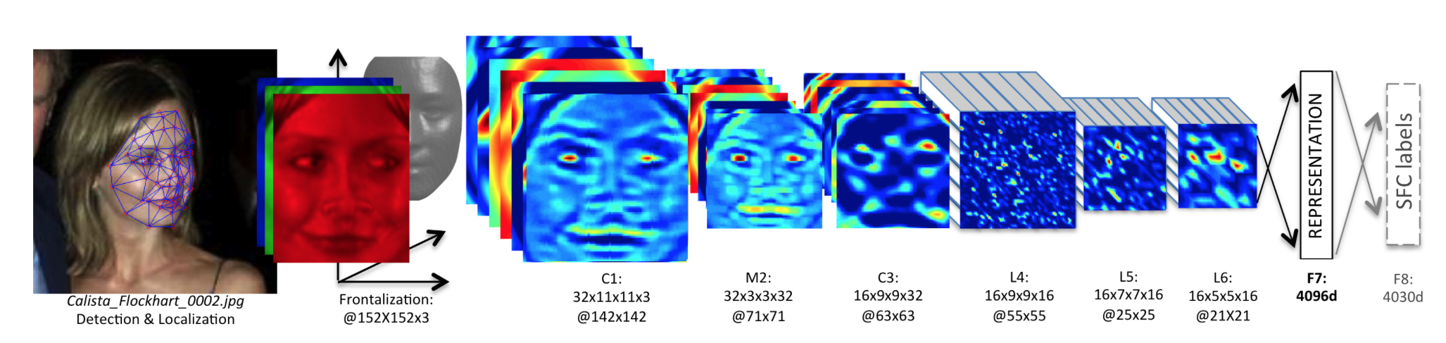
Face Recognition
Taigman, Yaniv, et al. "Deepface: Closing the gap to human-level performance in face verification." Proceedings of the IEEE Conference on Computer Vision and Pattern Recognition. 2014. [ PDF ]
Since 2014...

Slide 3
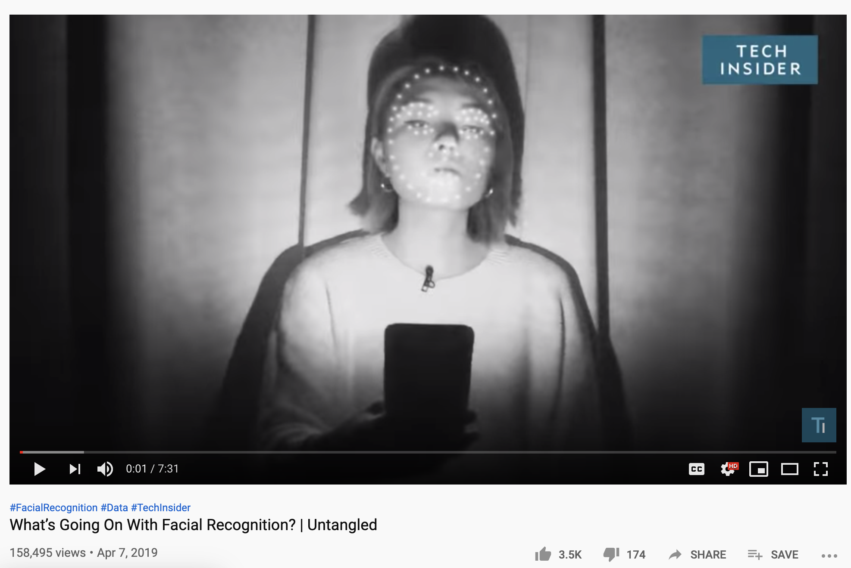
https://youtu.be/BqQT4sIOYA0
[ Tab-1 ]

Slide 4
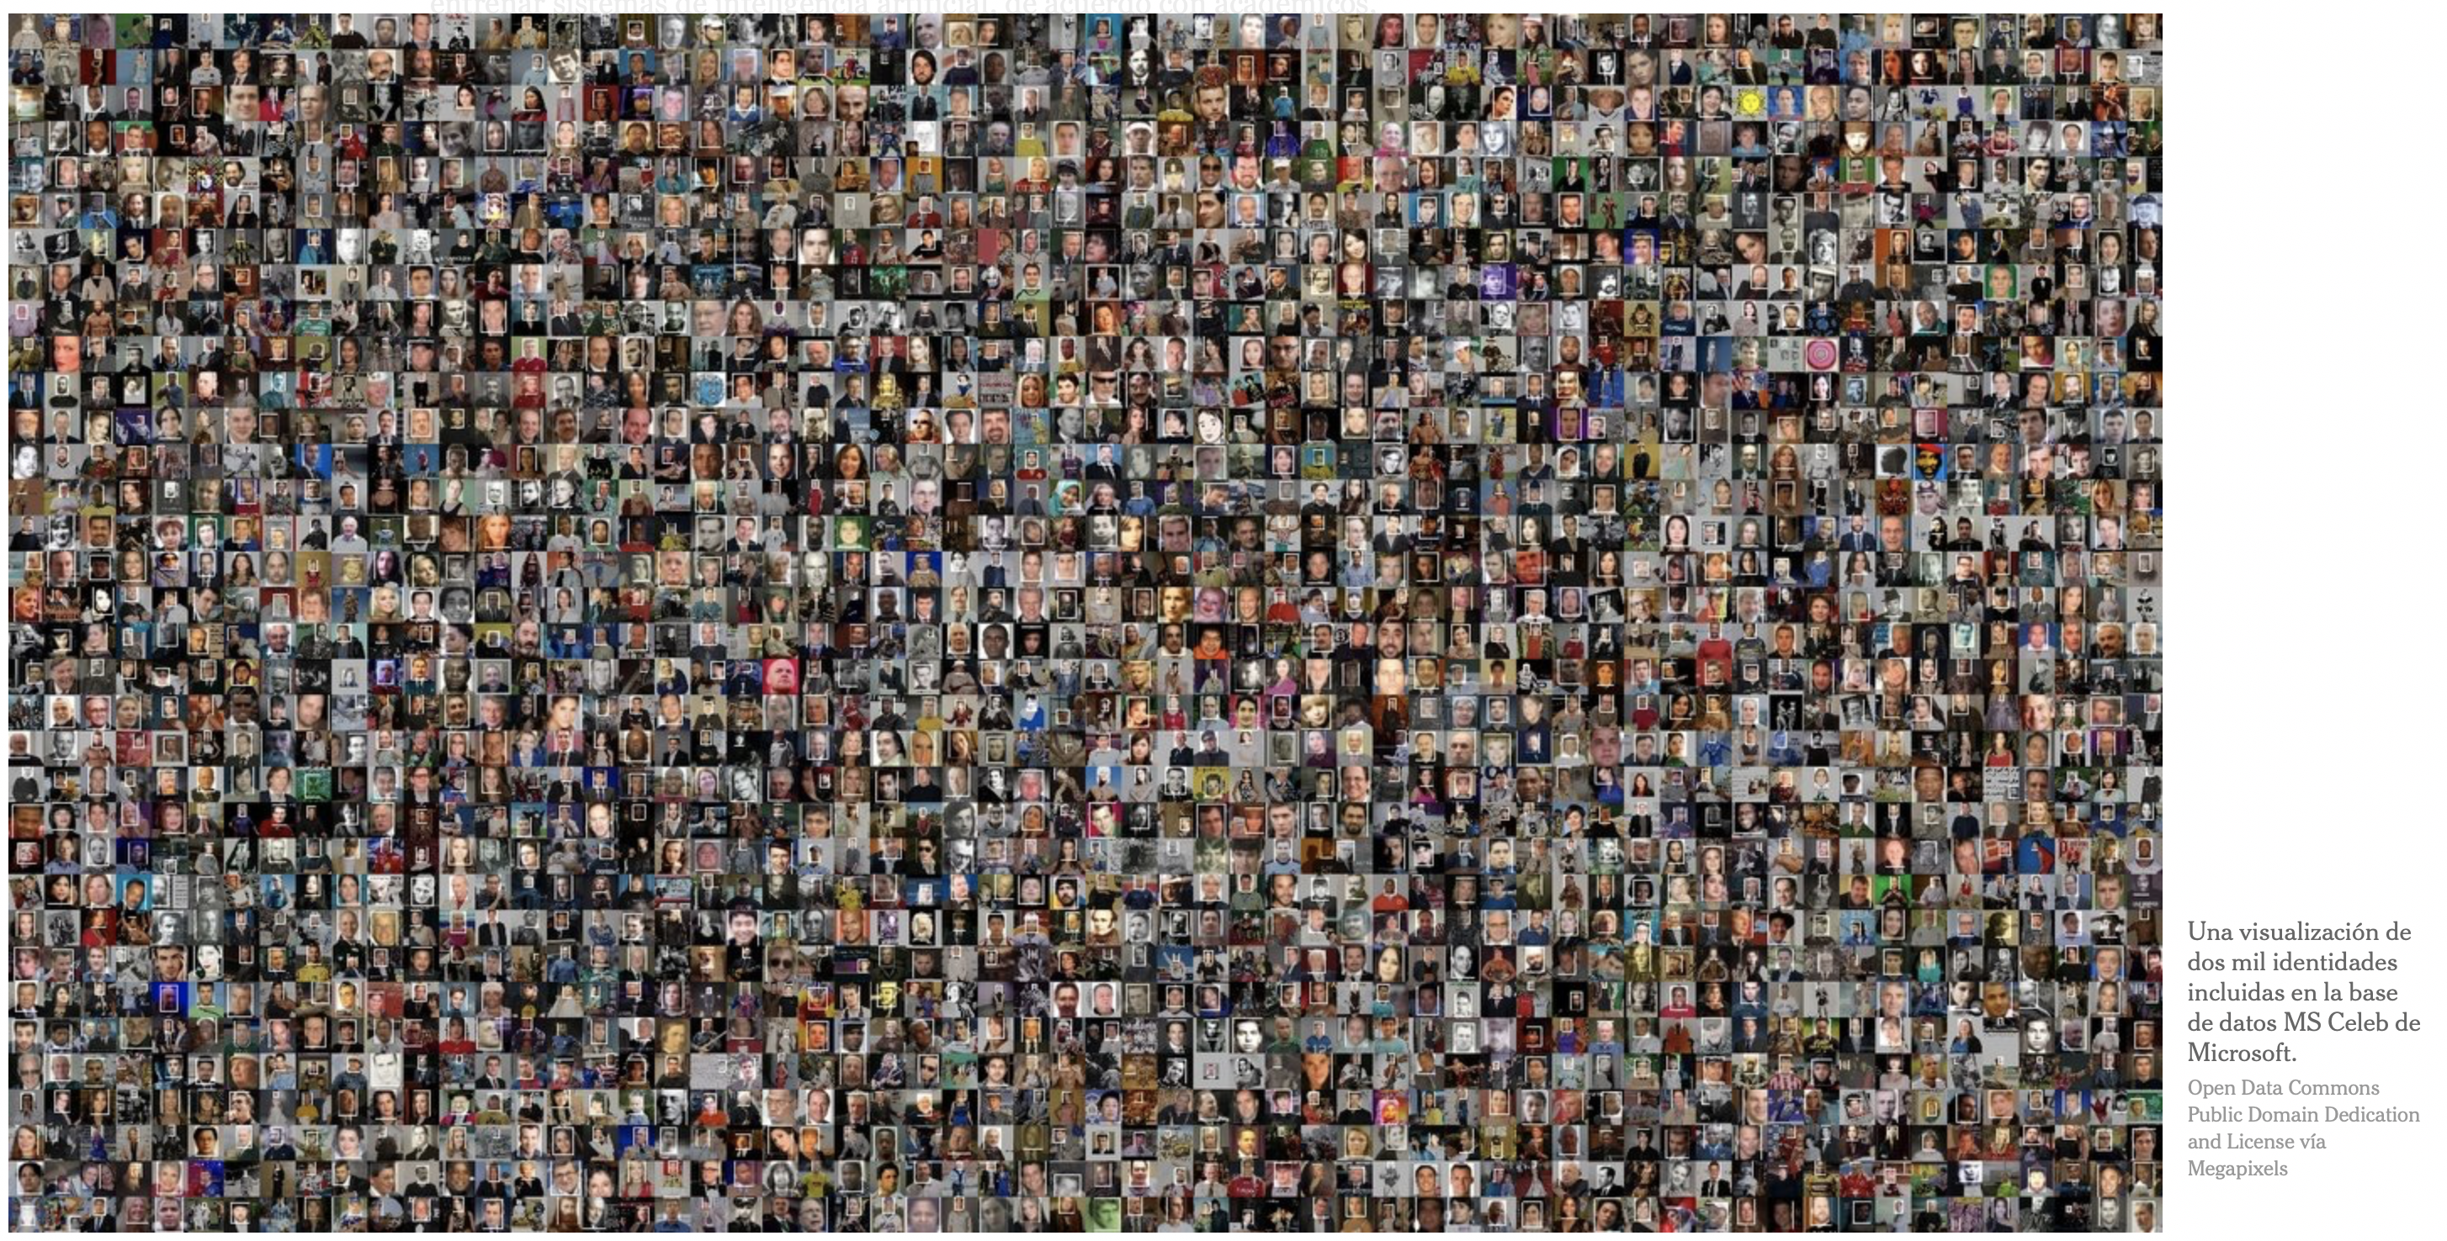
Tu rostro entrena herramientas de reconocimiento facial
https://www.nytimes.com/es/2019/07/15/reconocimiento-facial-tecnologia

Slide 5
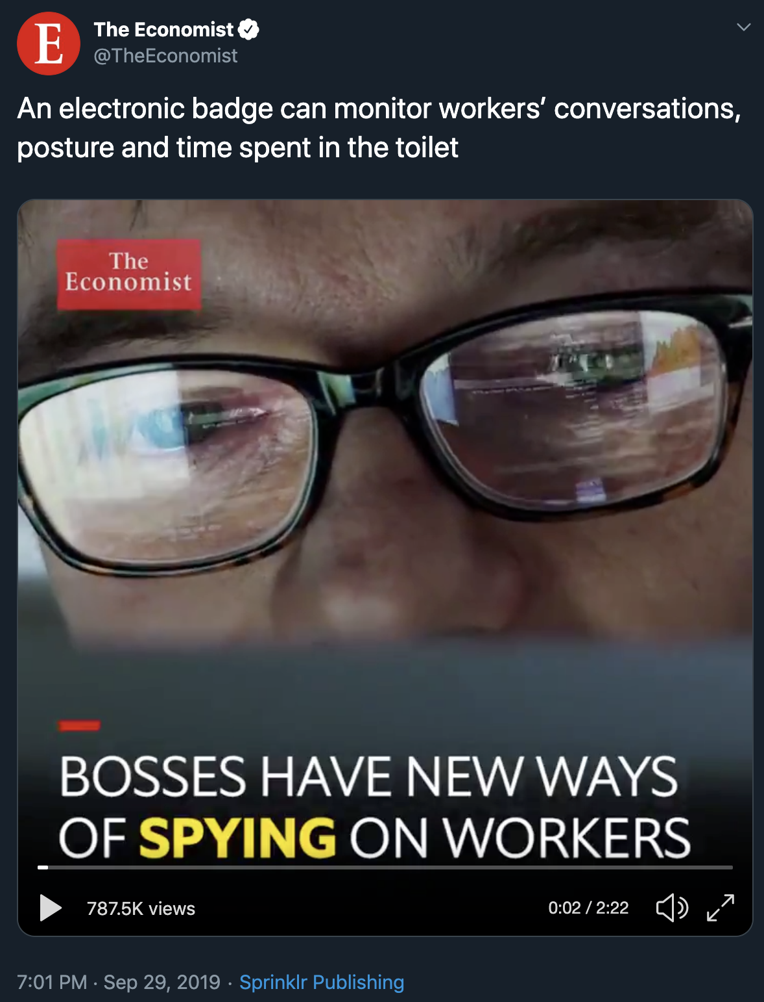
https://bit.ly/2IUNHlW
[ Tab-2 ]

Slide 6
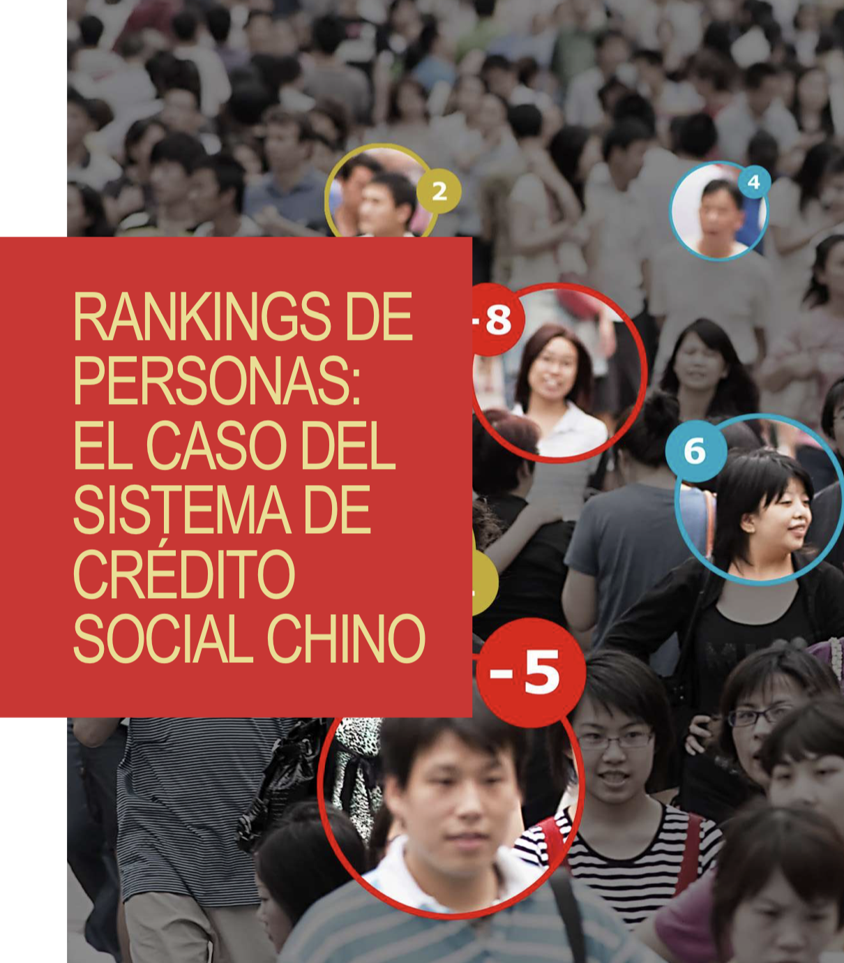
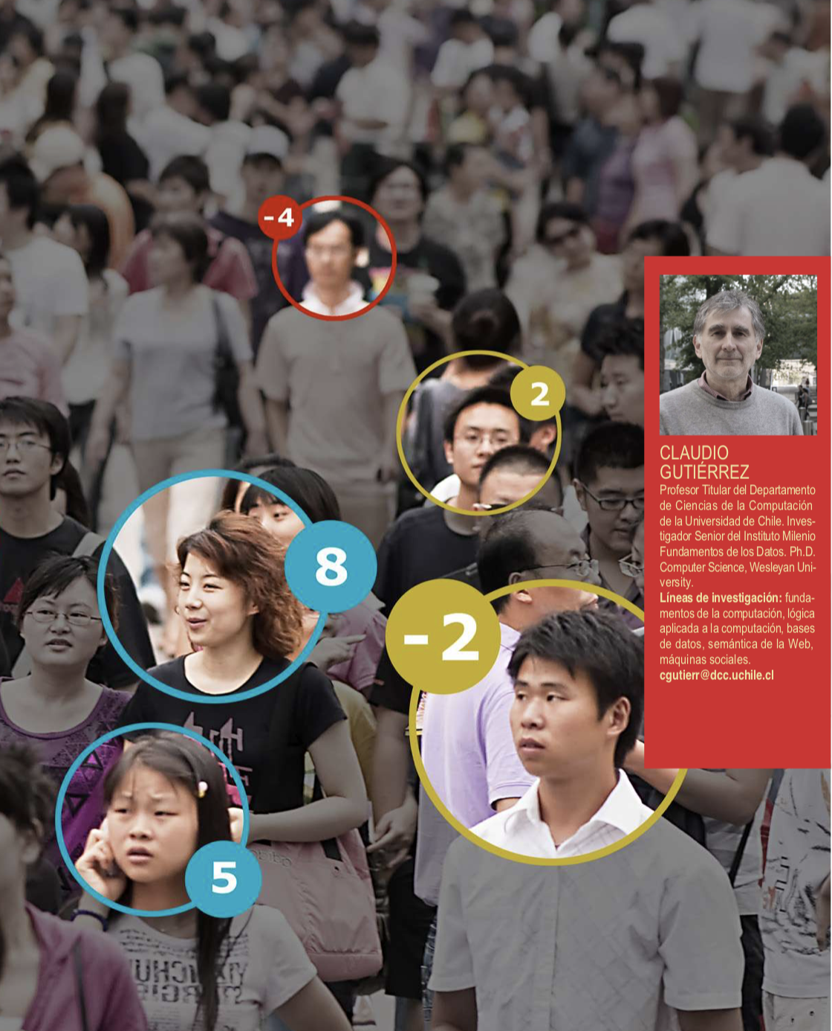
https://www.dcc.uchile.cl/Bitsdeciencia17.pdf > pag. 38

Slide 7
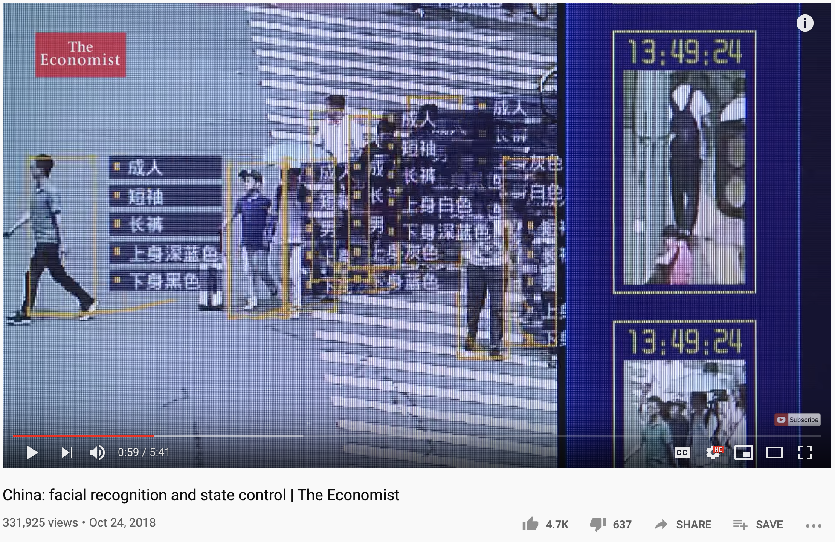
https://youtu.be/lH2gMNrUuEY
[ Tab-3 ]

Slide 8
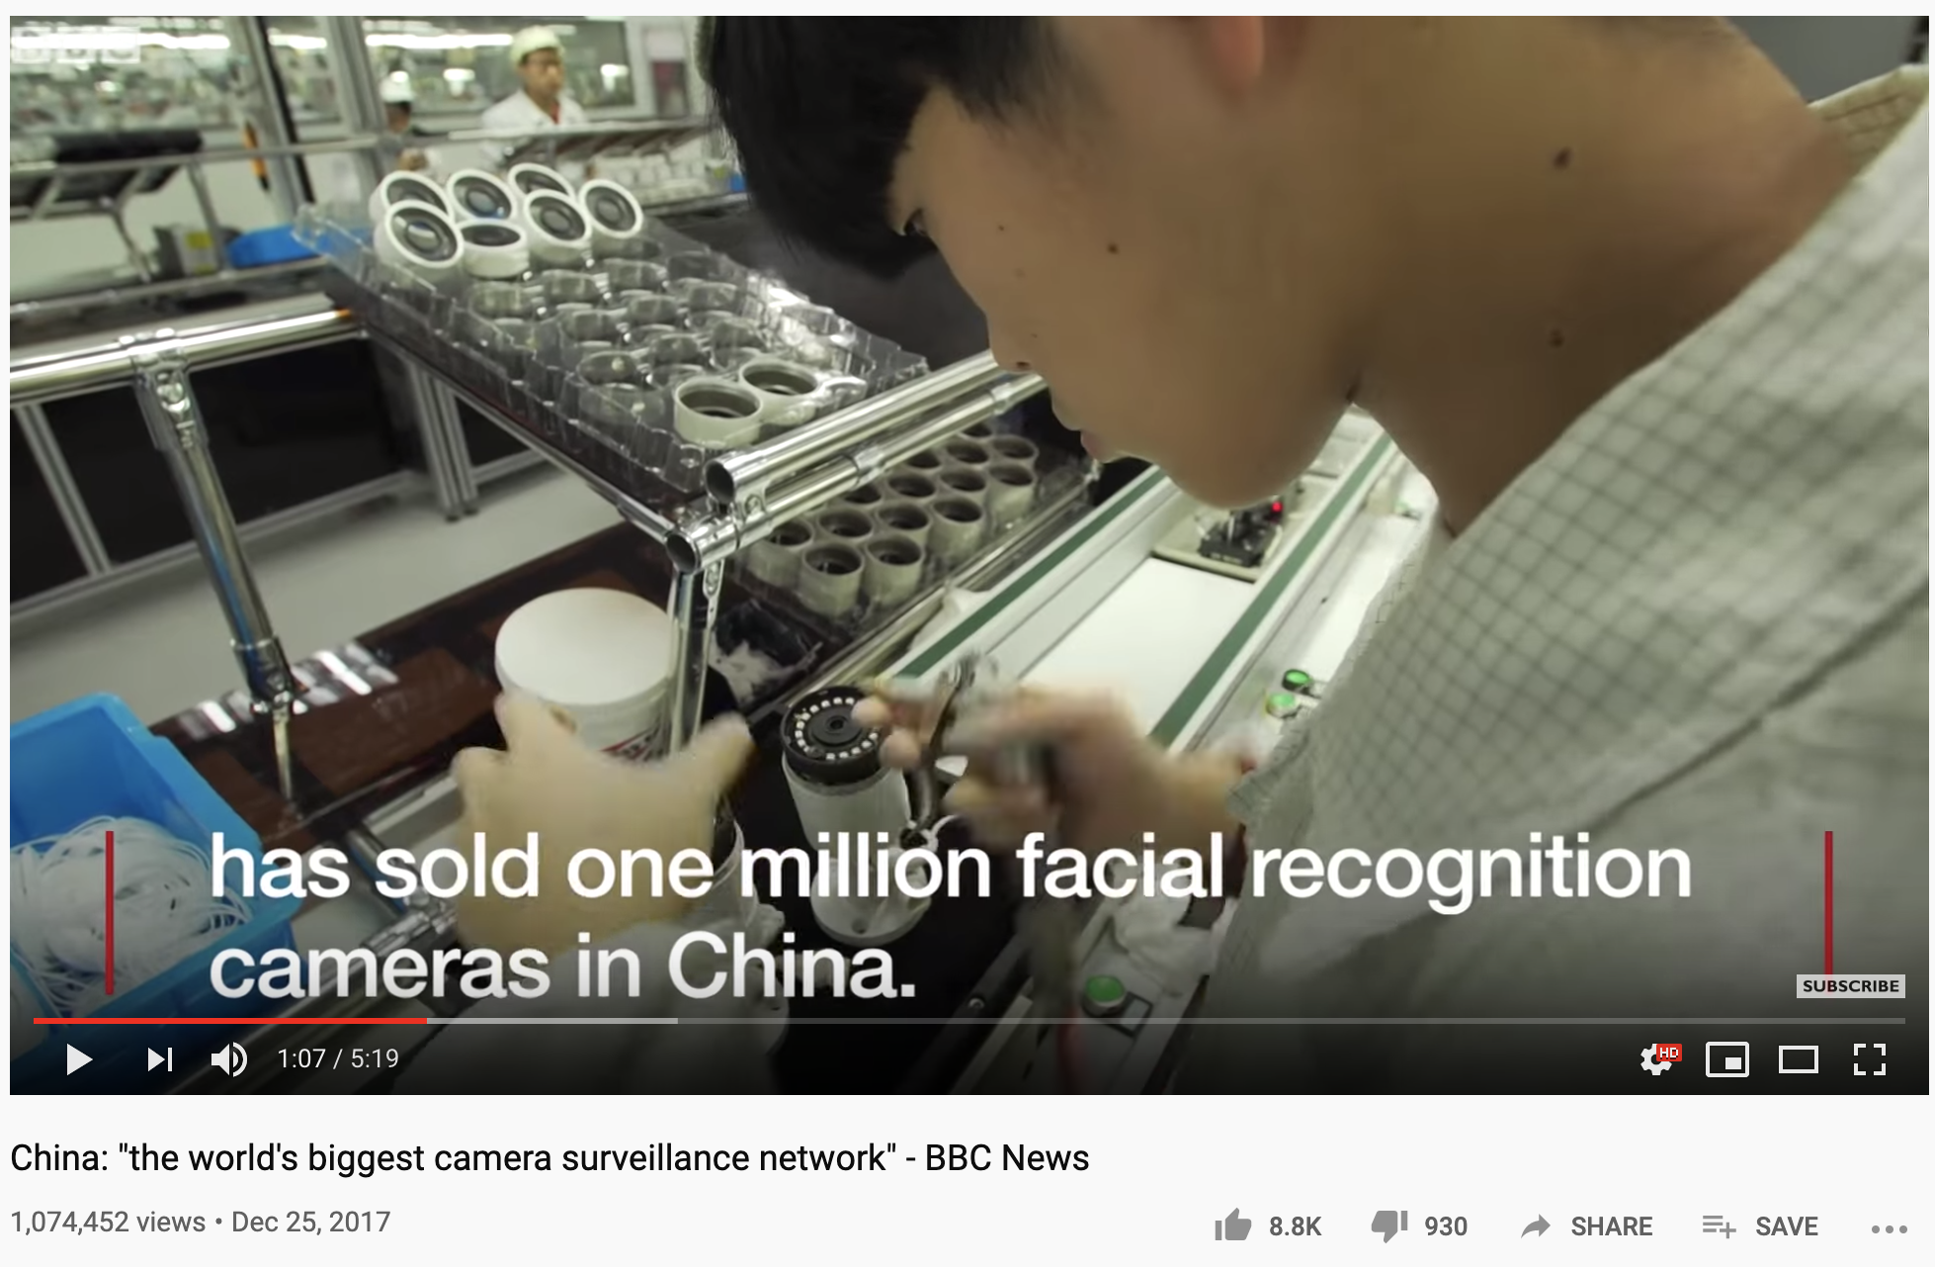
https://youtu.be/pNf4-d6fDoY
[ Tab-4 ]

Slide 9
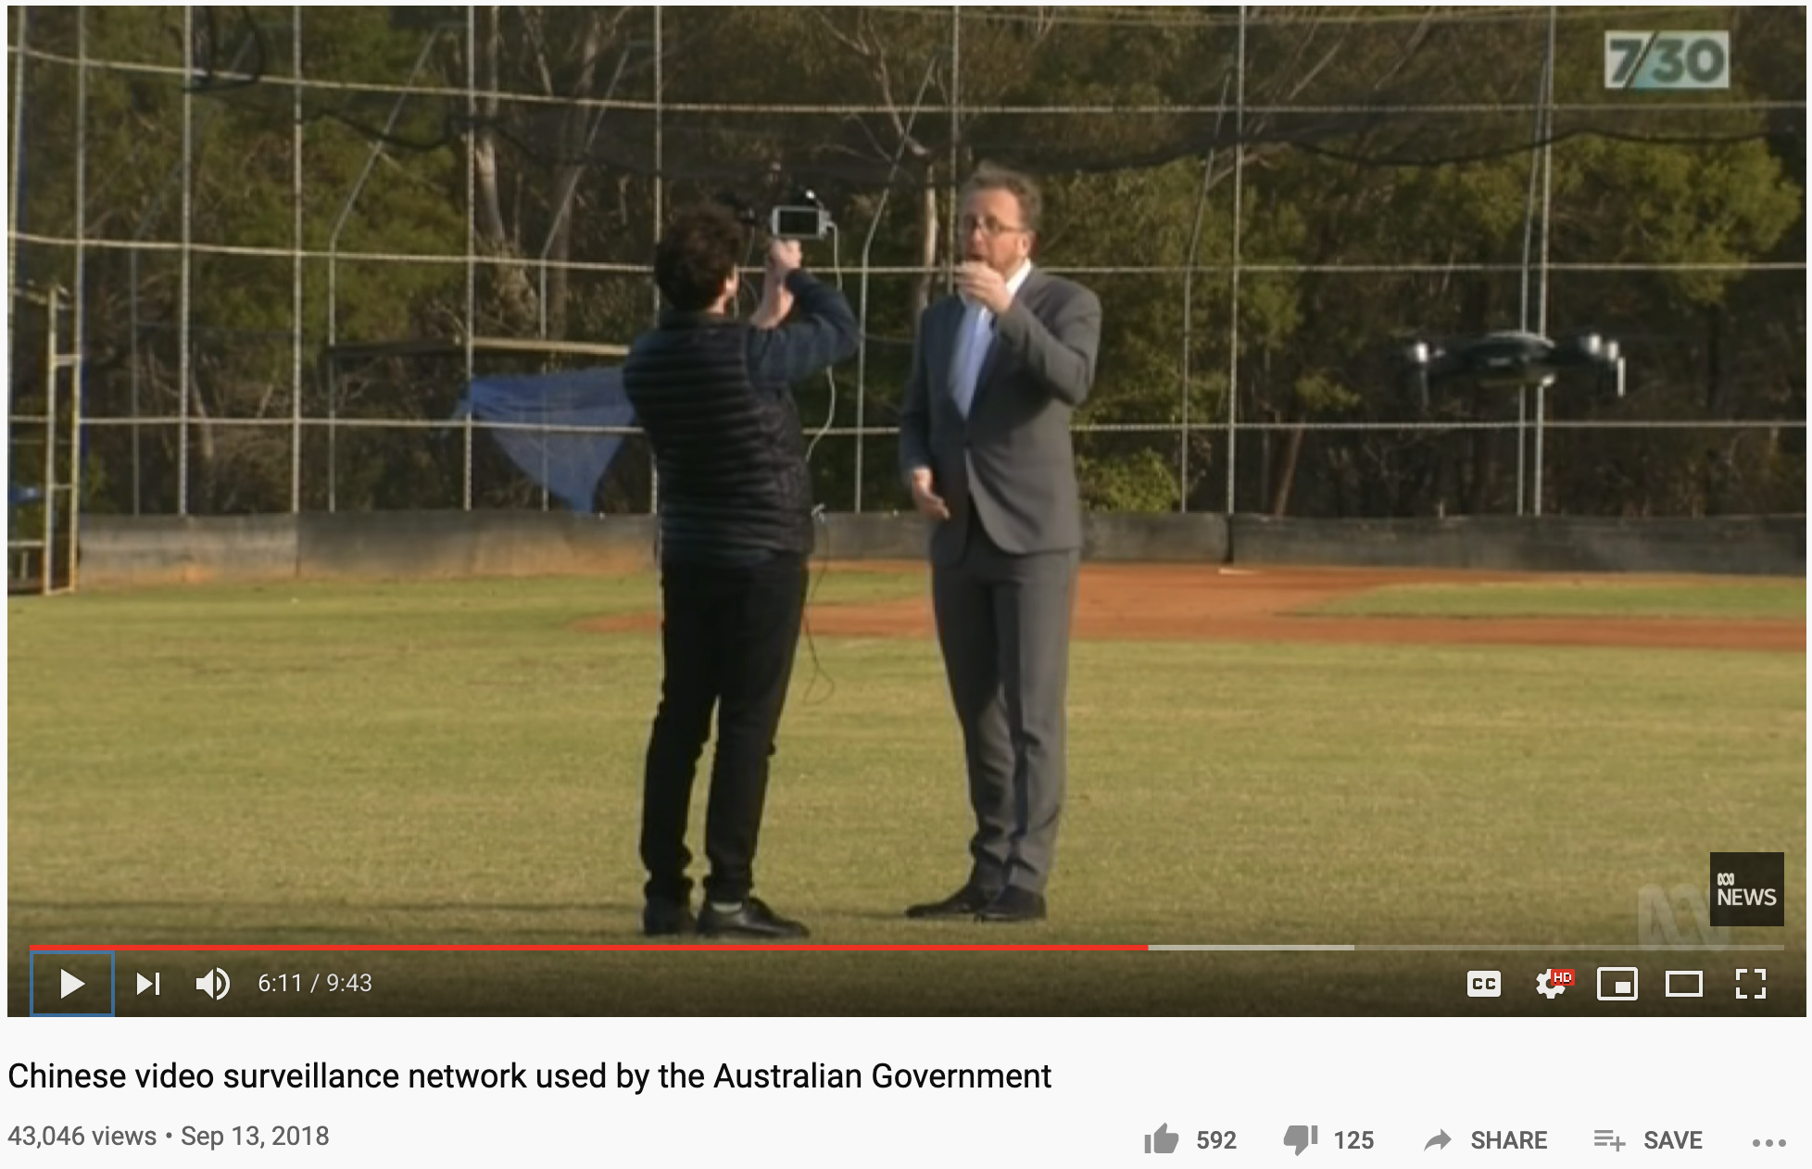
drone
https://youtu.be/B4QK3jJkLR8
[ Tab-5 : 5:00 ]

Slide 10
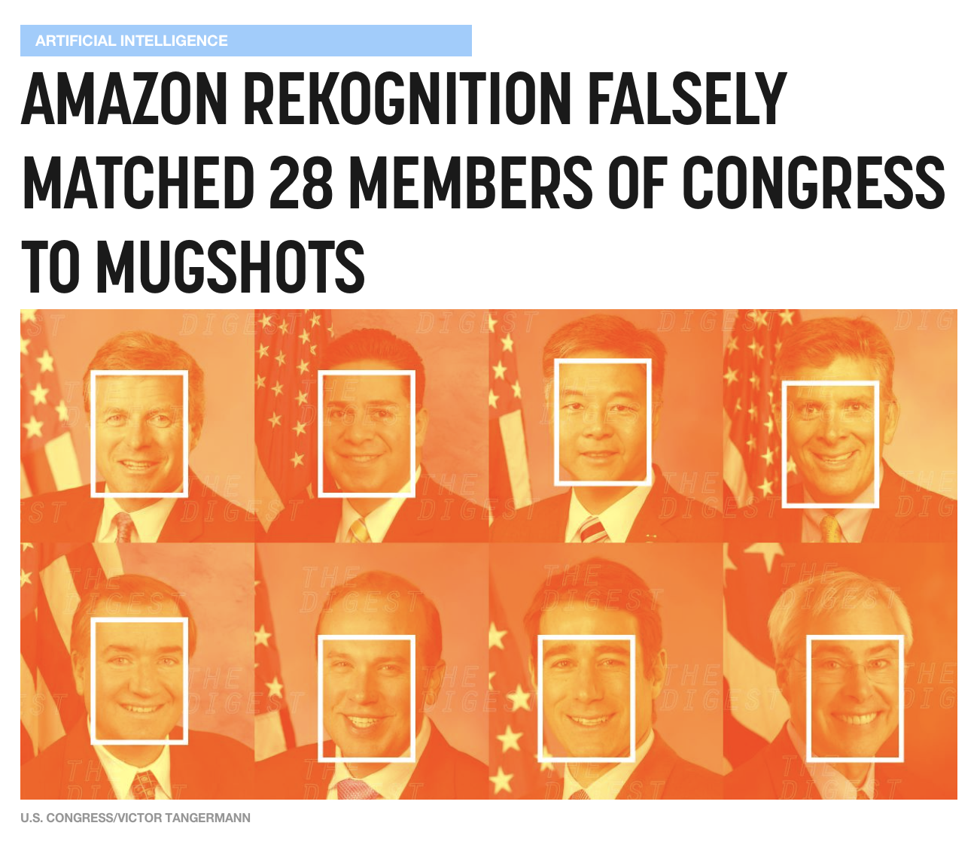
https://bit.ly/31m739O

Slide 11
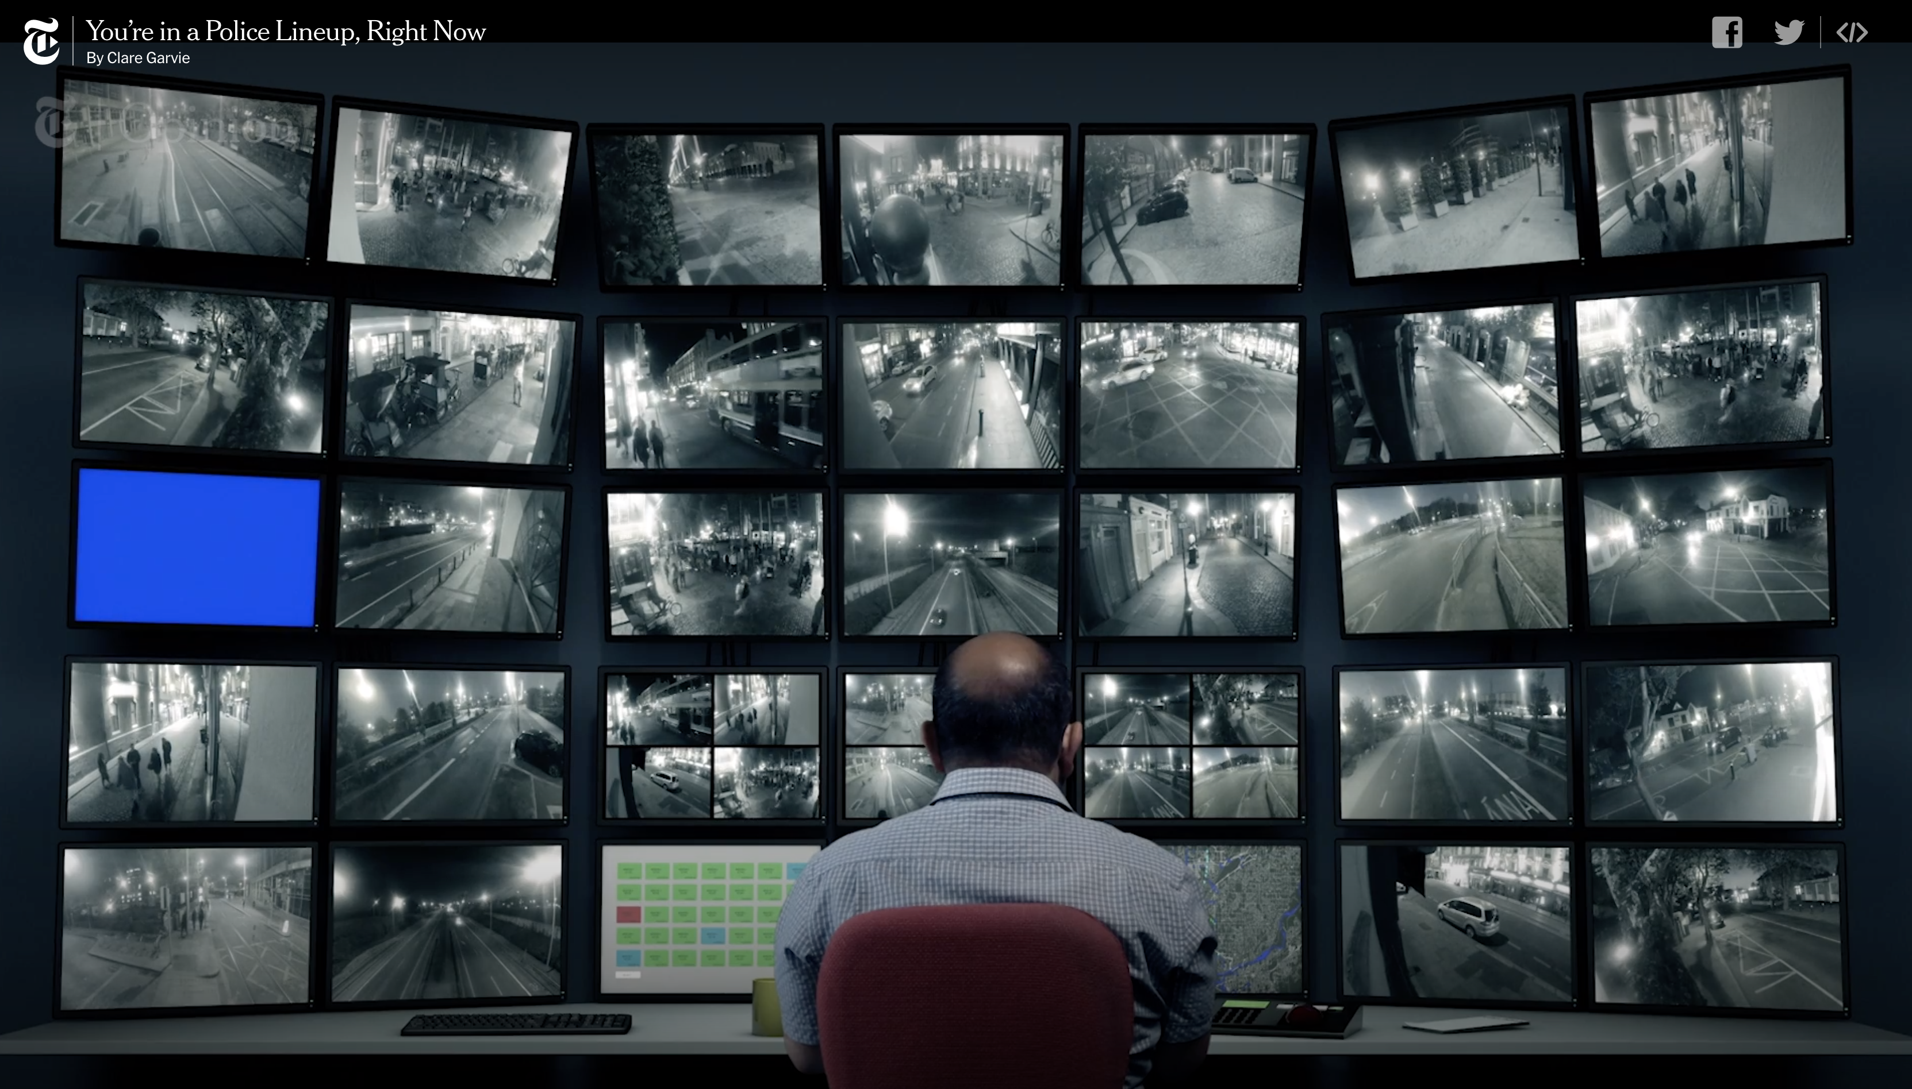
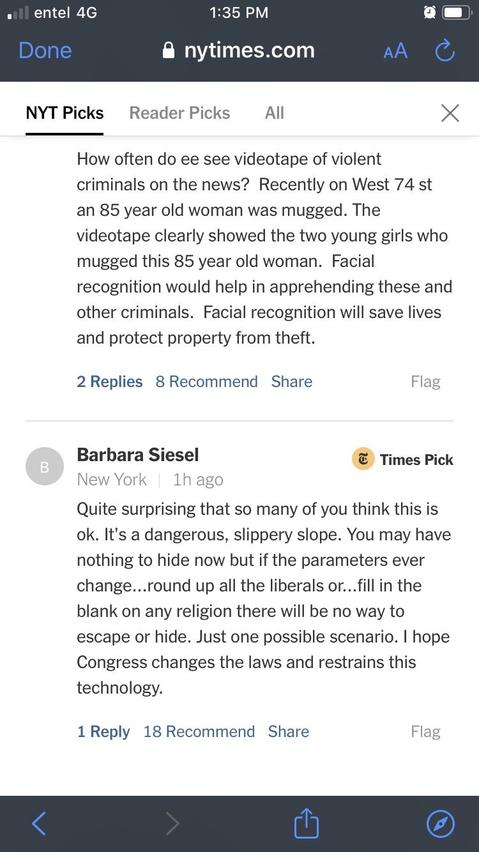
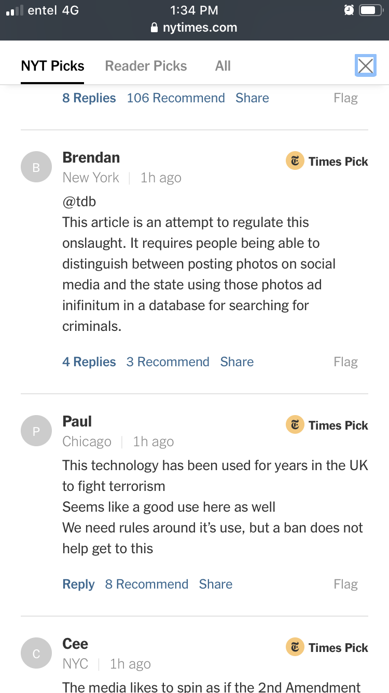
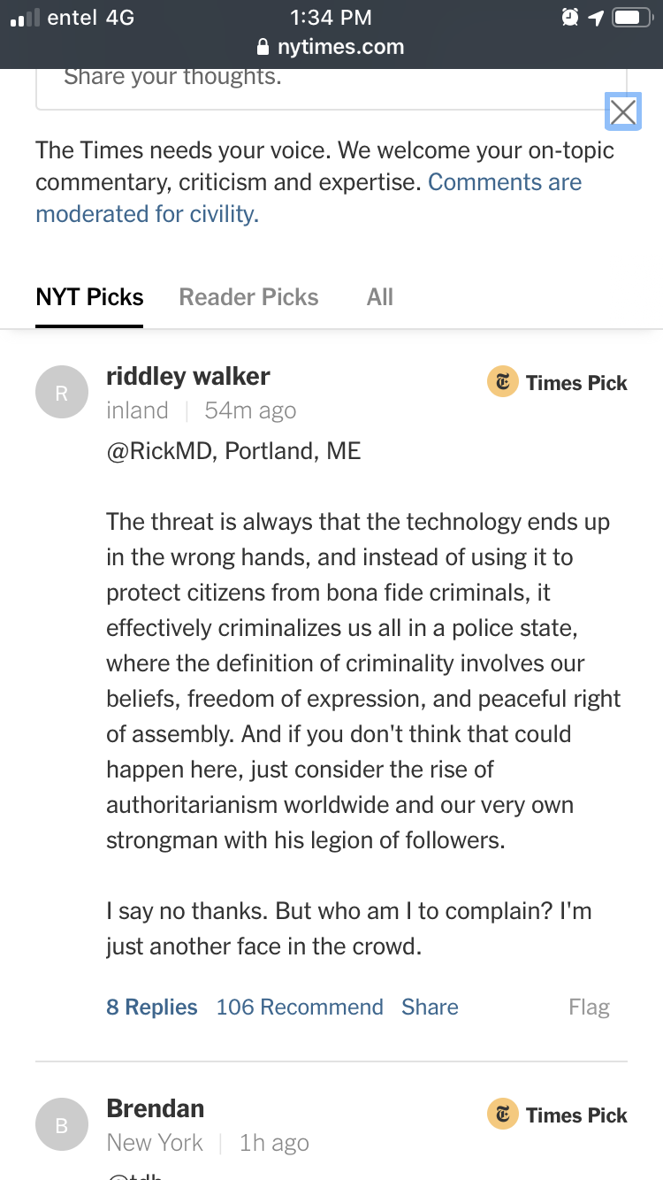
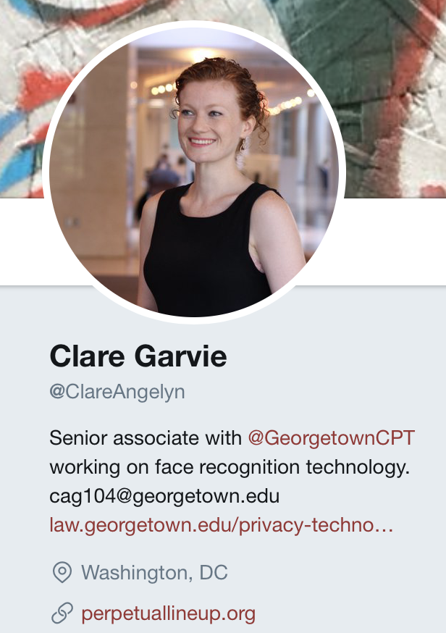
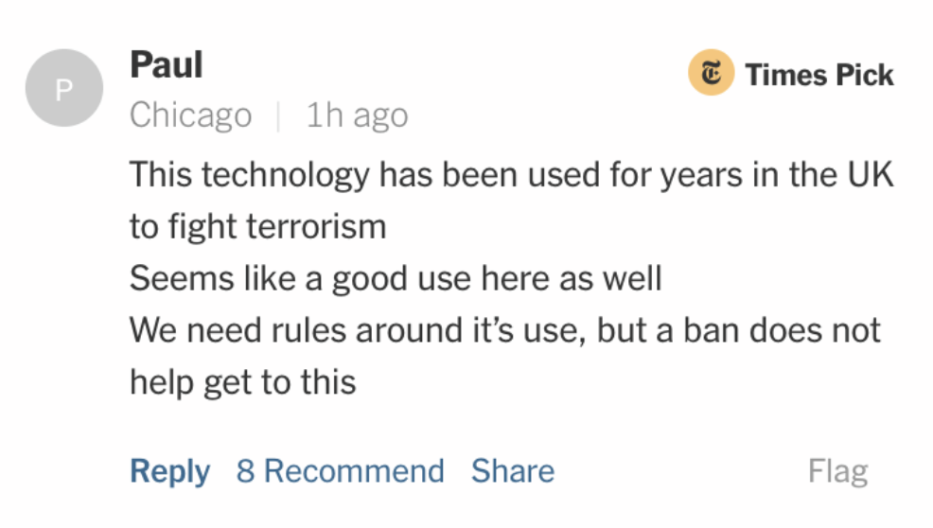
Twitter: @ClareAngelyn
https://nyti.ms/2OQcT0A
[ Tab-6 ]

Slide 12
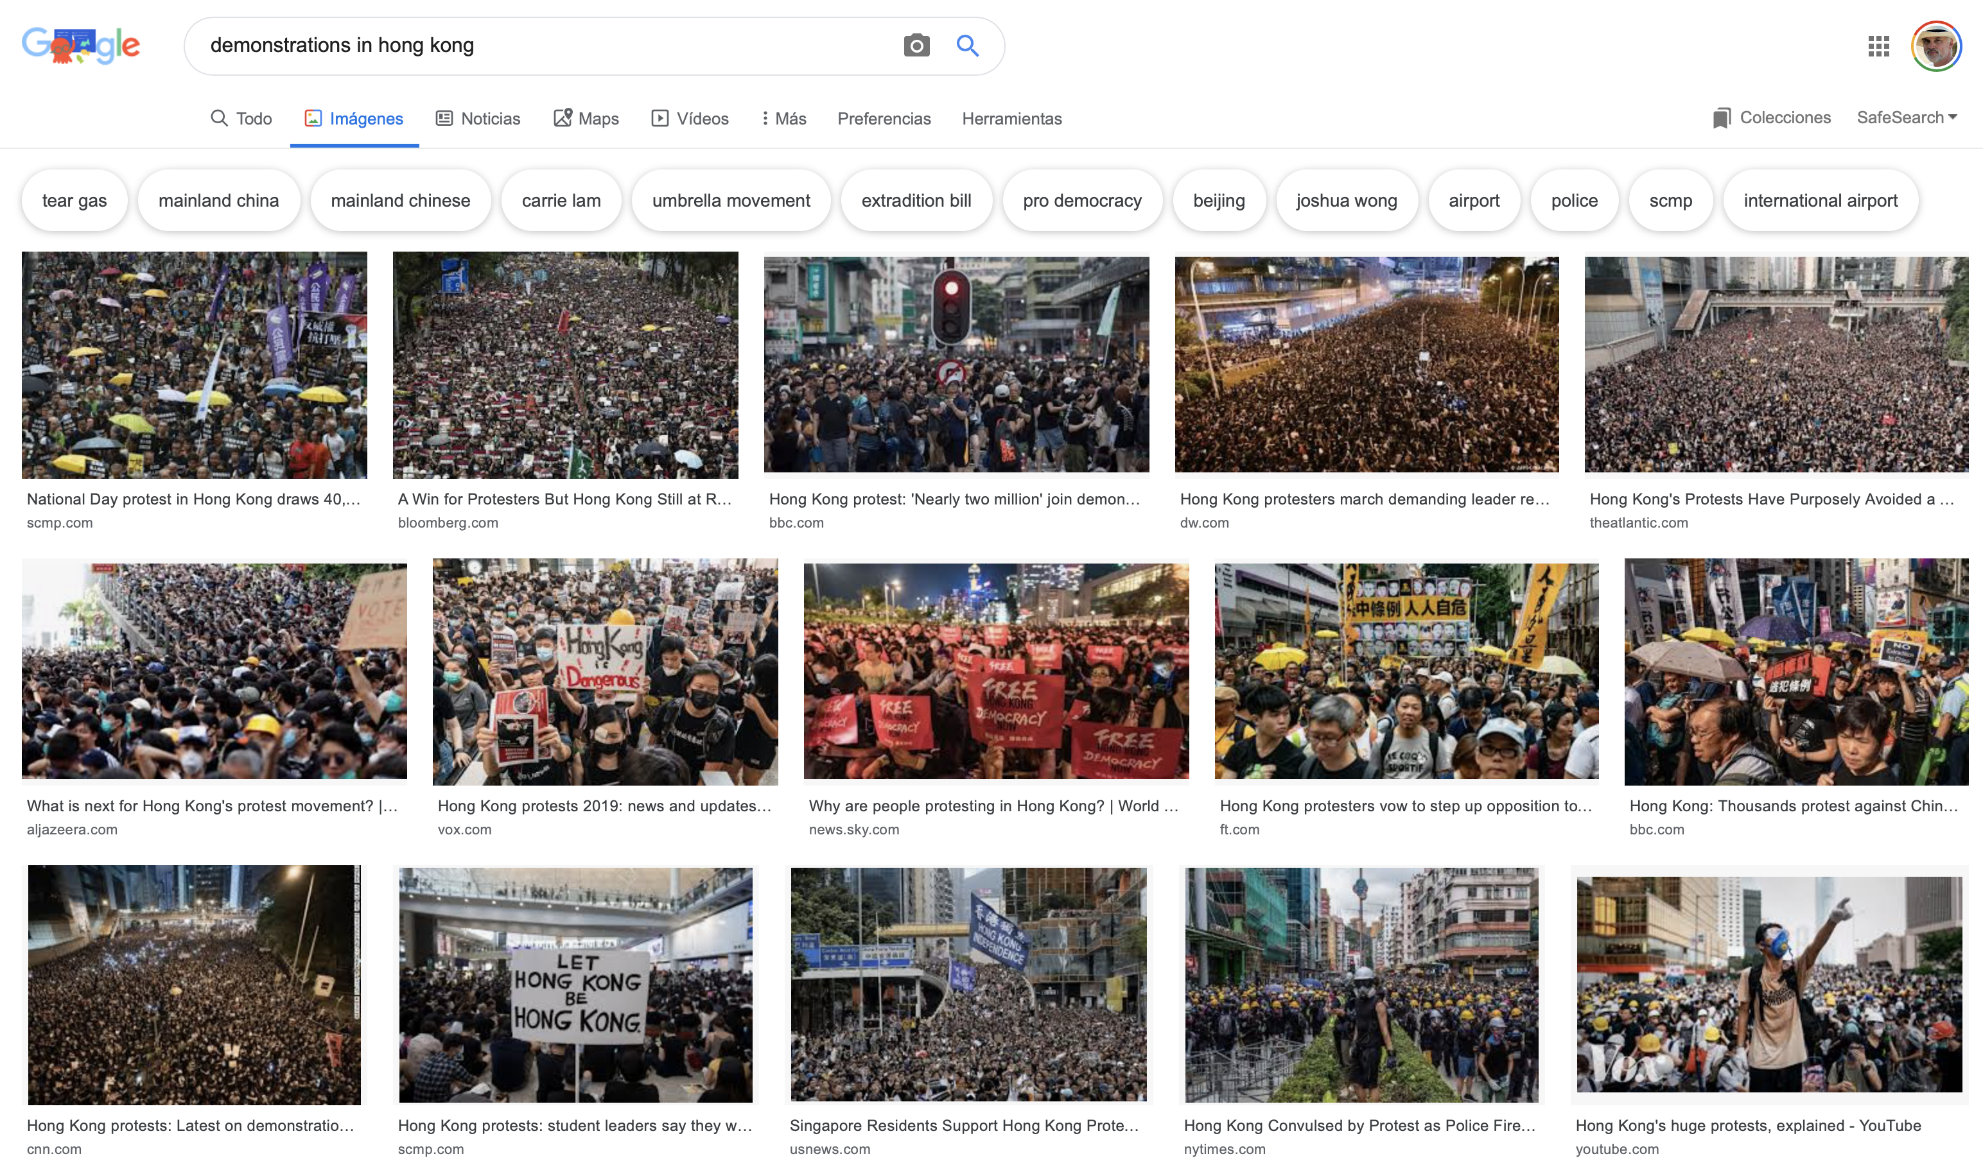
Demonstrations in Hong Kong (2019)

Slide 13
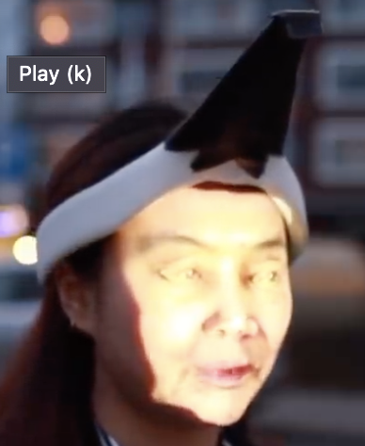
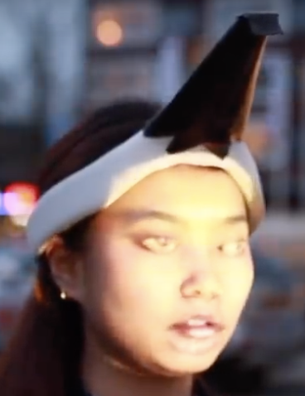
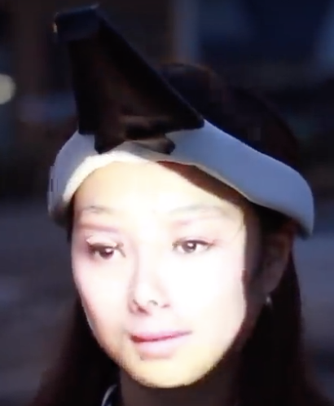
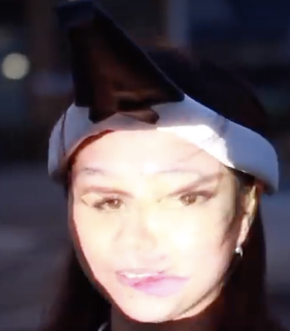
Ant-facial recognition tech at the Hong Kong protests
https://bit.ly/2Bes2ko
[ Tab-7 ]

Slide 14
Surveillance Exclusion

Slide 15
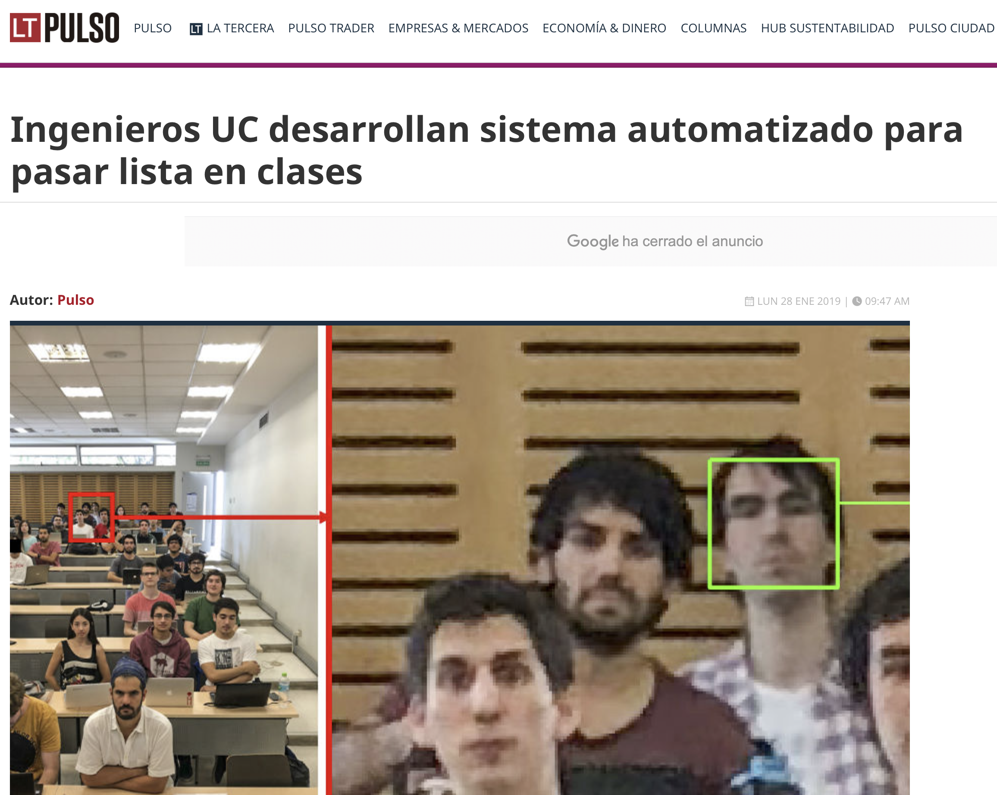
https://t.co/W1YkLOvCao

Slide 16
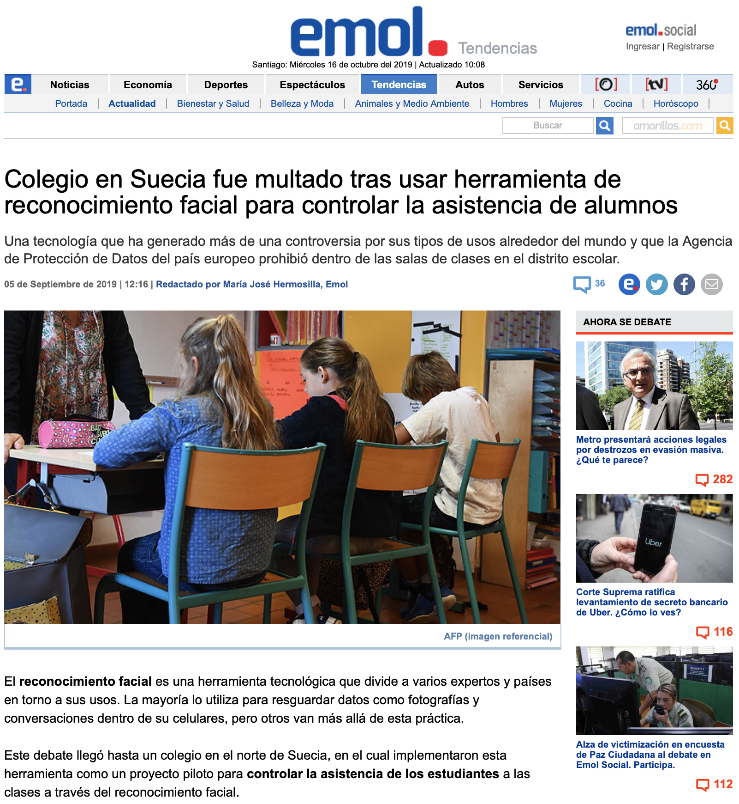
https://bit.ly/2kjPV5n

Slide 17
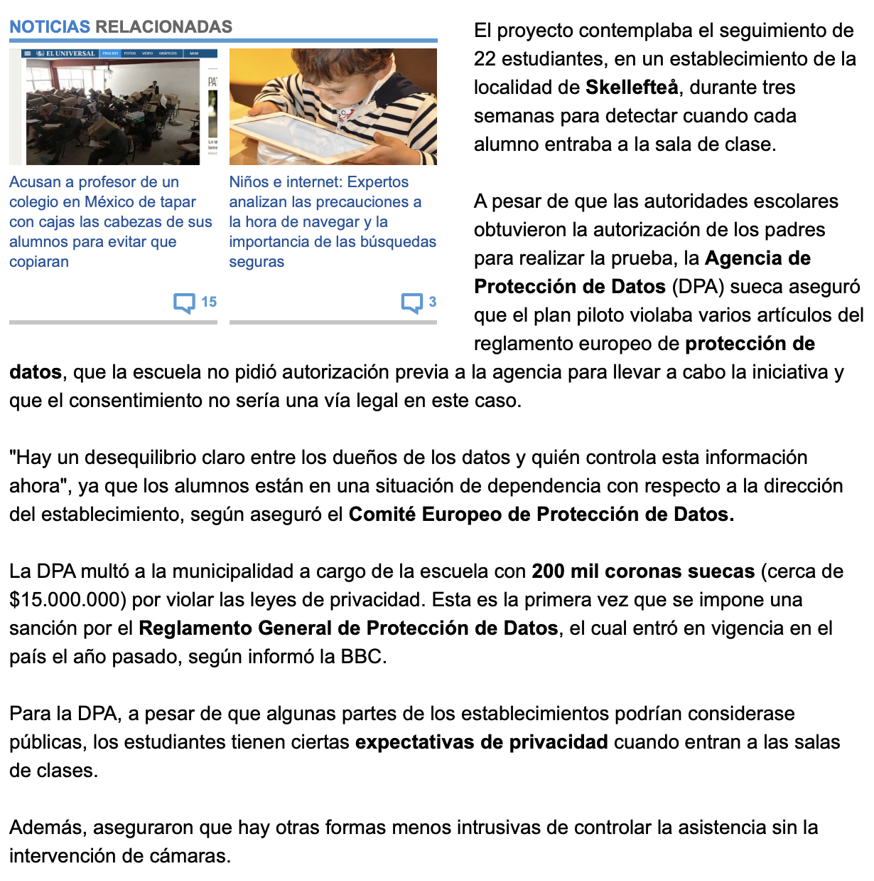
Colegio en Suecia fue multado ...

Slide 18
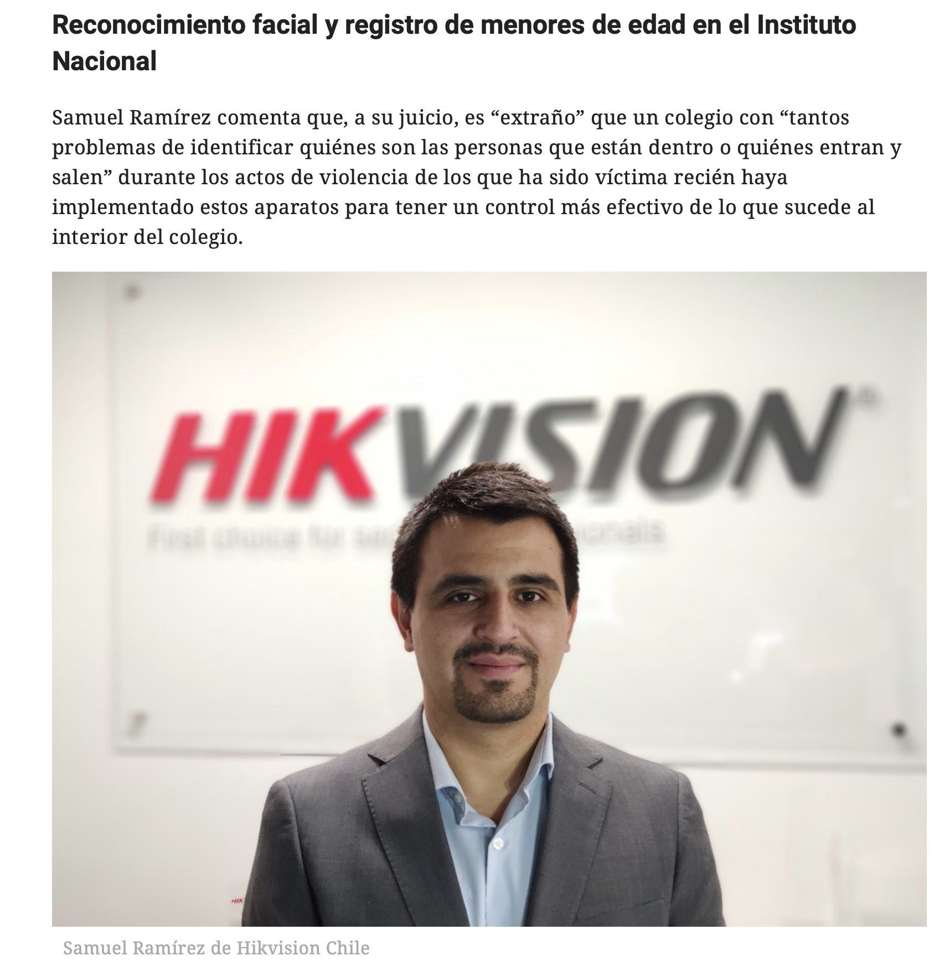
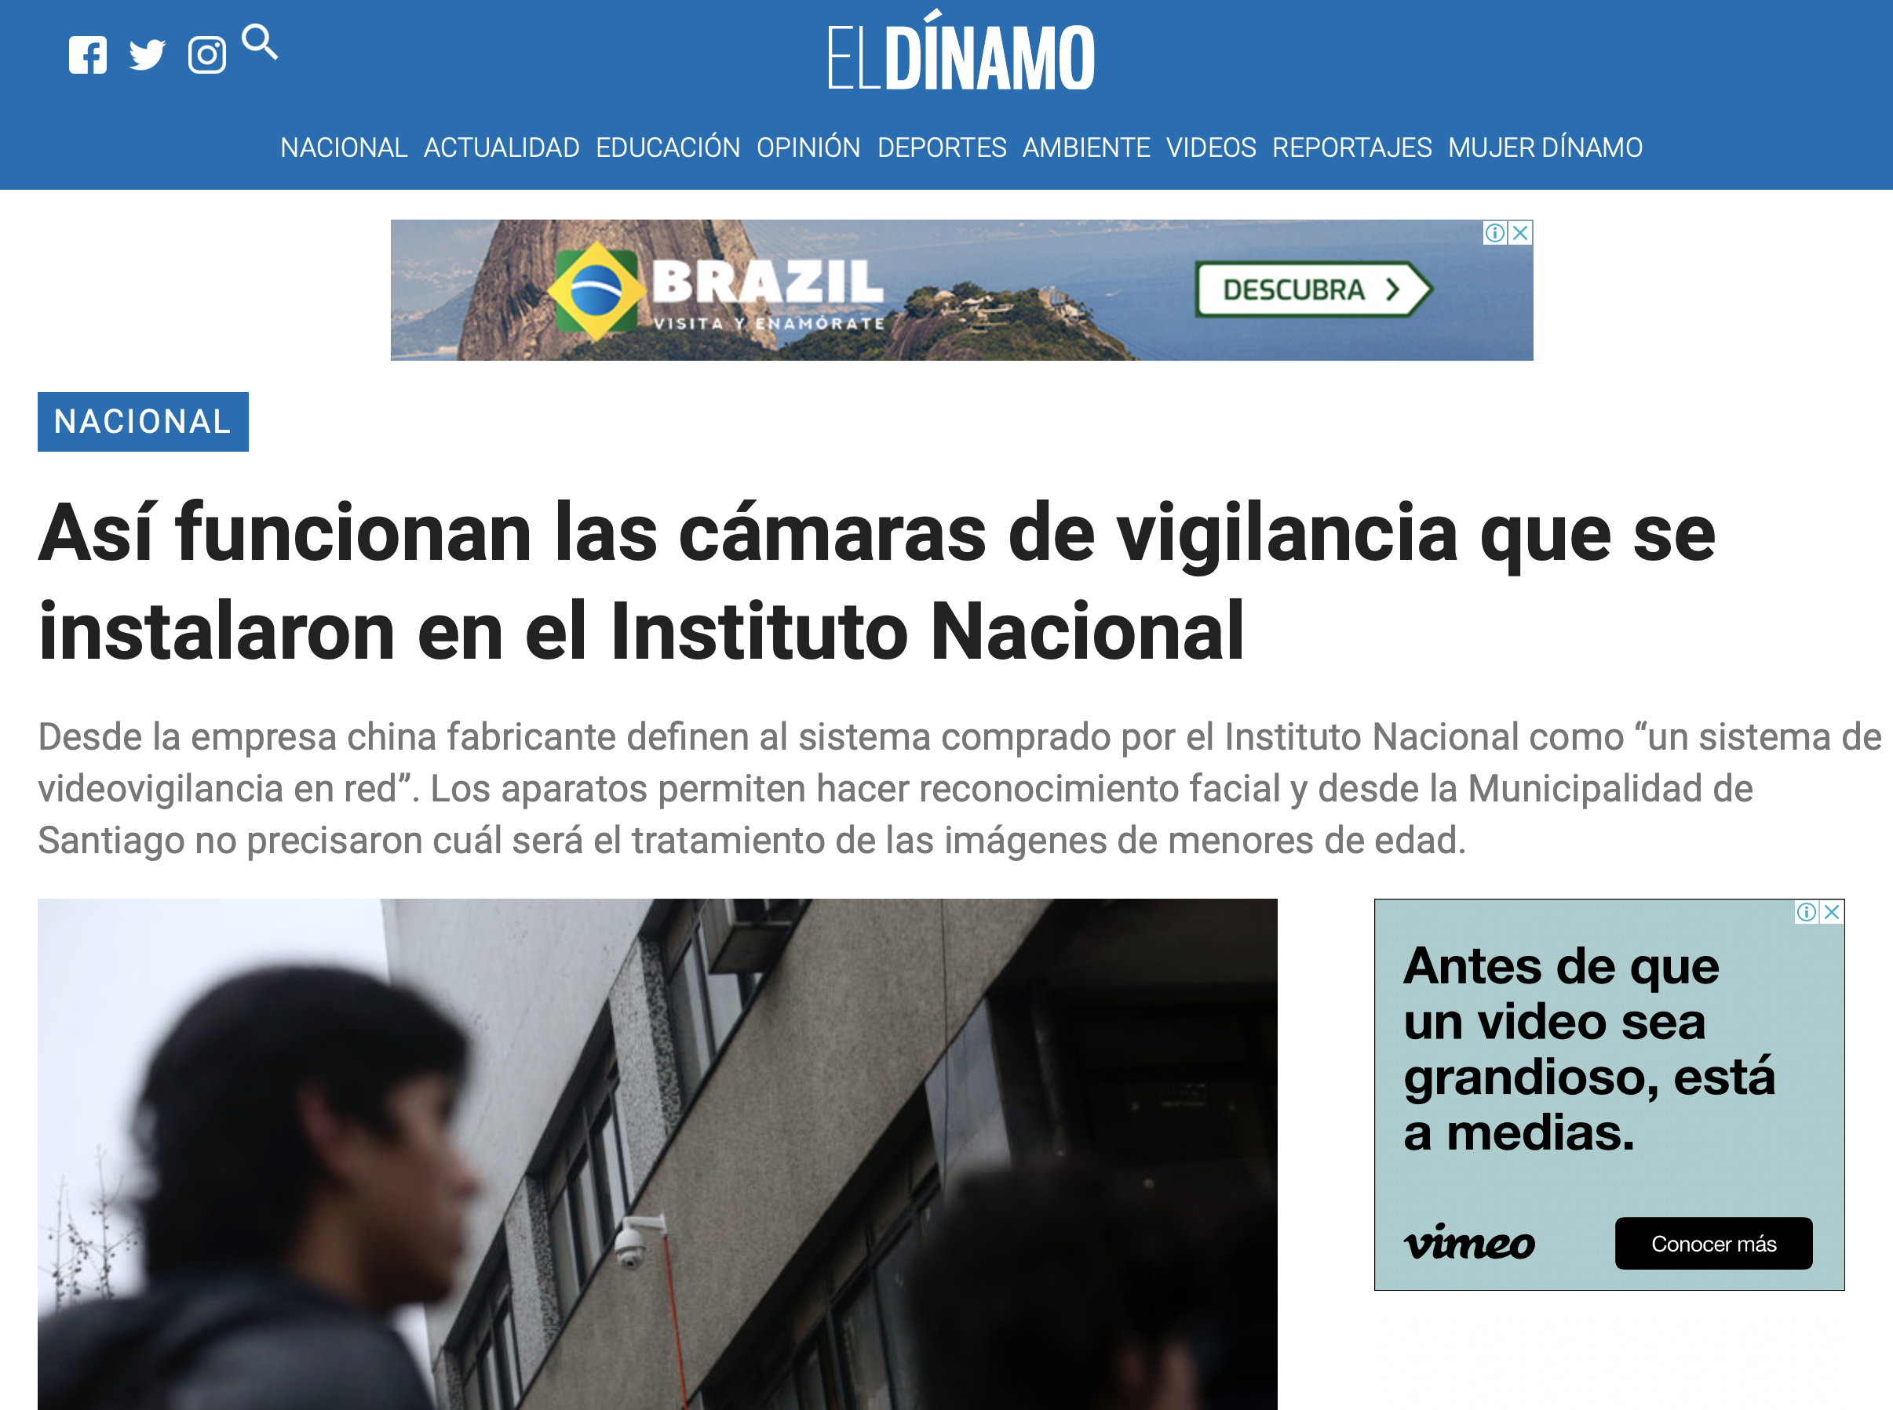
https://bit.ly/2YN6Ax0

Slide 19
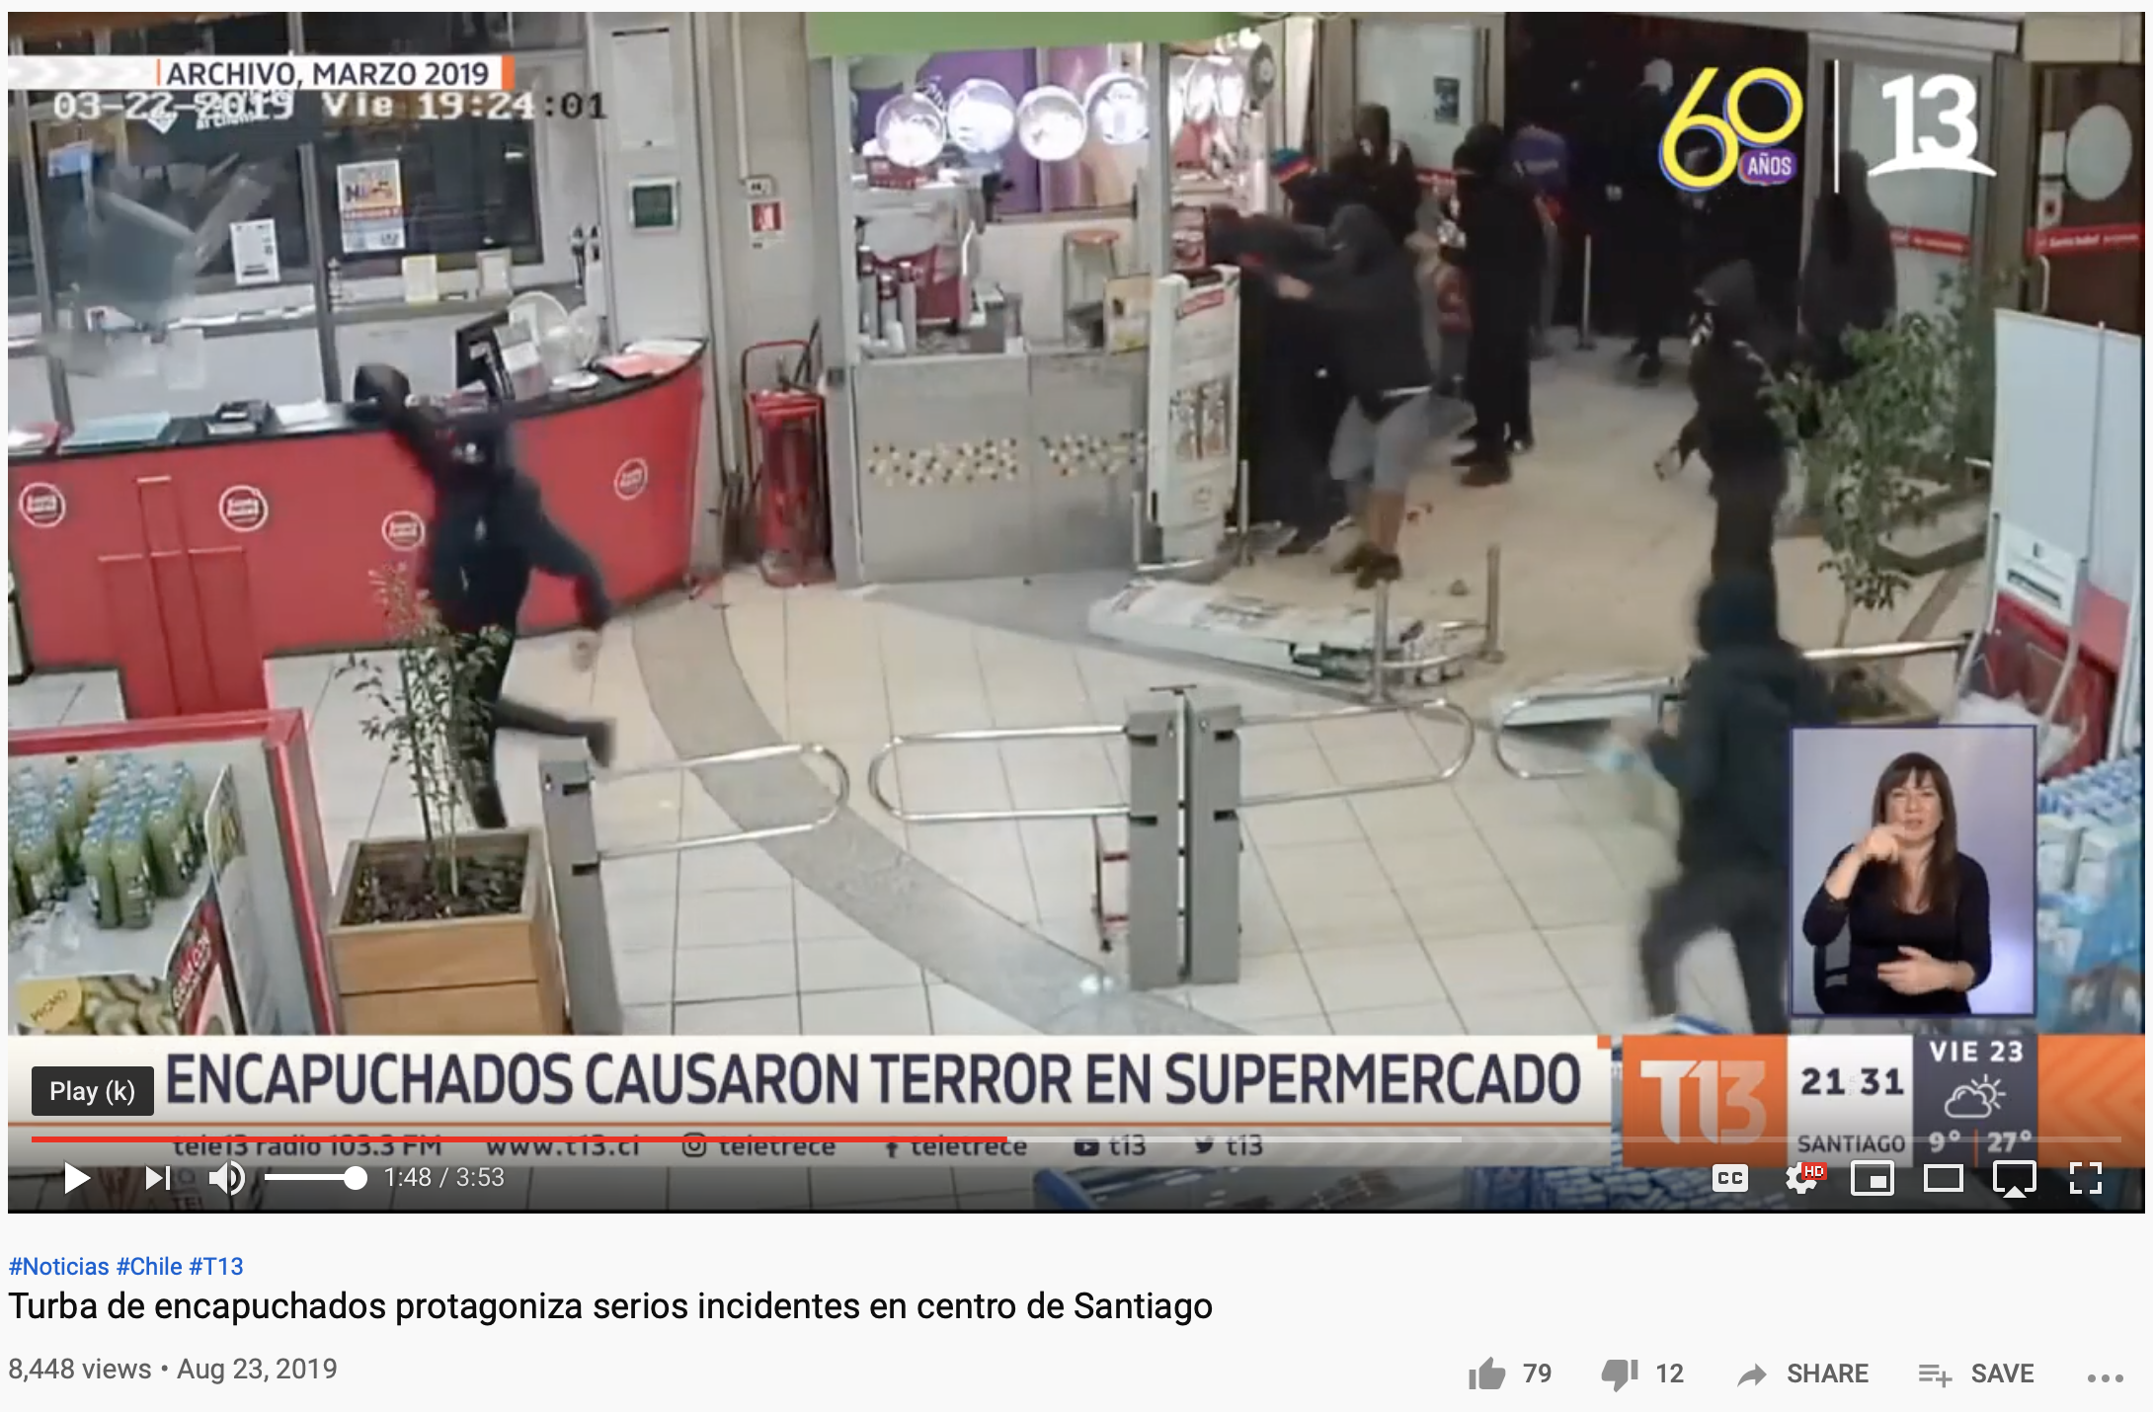
https://youtu.be/PvaWJvQ8JoM
[ Tab-8 : 1:40 ]

Slide 20
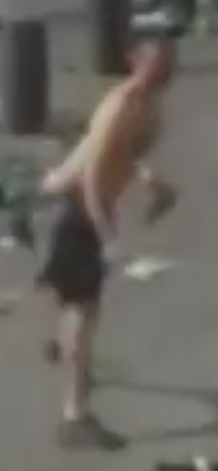
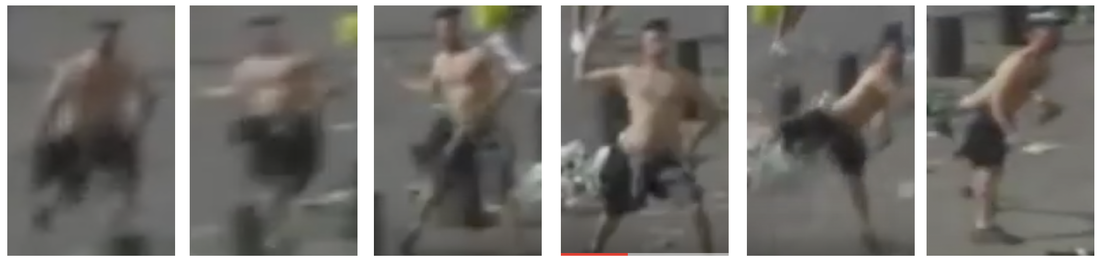
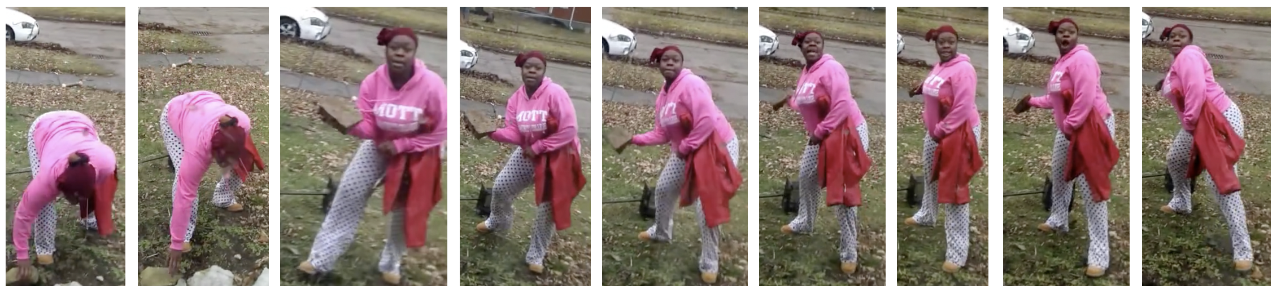
Face Recognition in Low Quality Face Images
[ London ]
[ U.S.A. ]

Slide 21
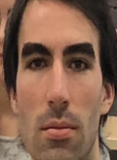
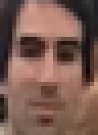
Face Recognition in Low Quality Face Images
[ FONDECYT con Sicología UC, Notre Dame, Texas ]

Slide 22



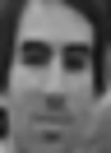




Slide 23

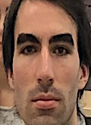
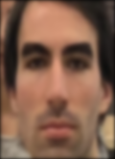
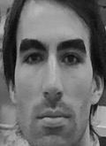

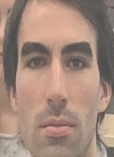

Slide 24
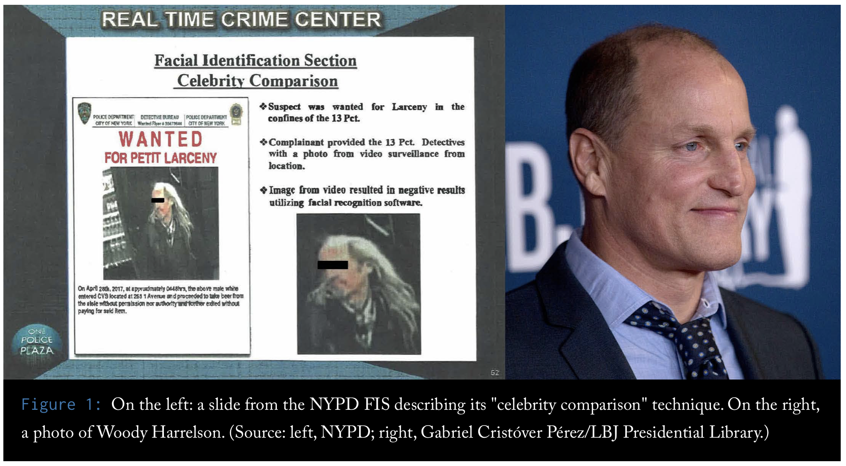
How is used Facial Recognition in practice?
https://www.flawedfacedata.com

Slide 25
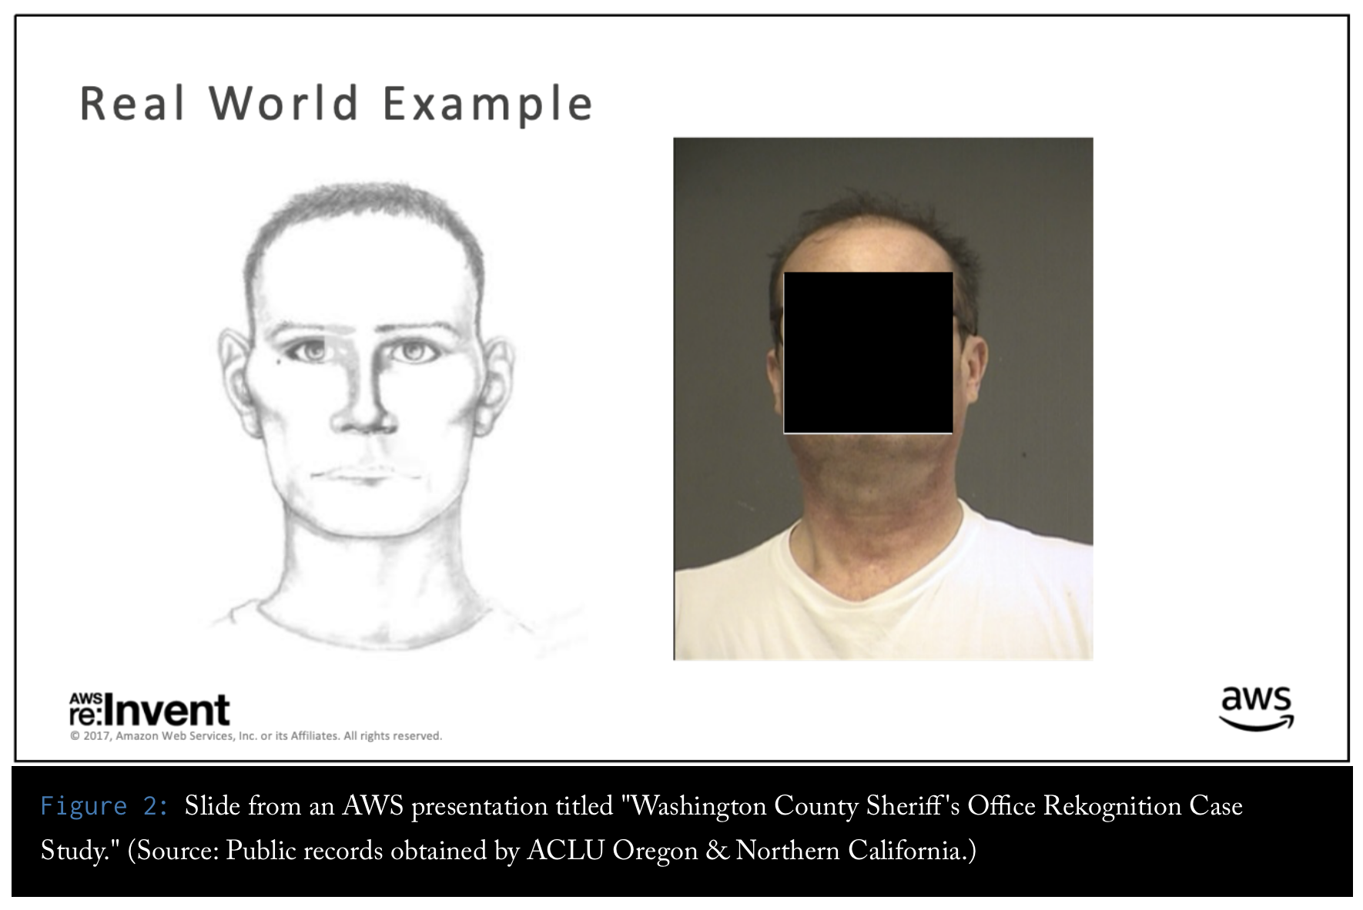
https://www.flawedfacedata.com

Slide 26
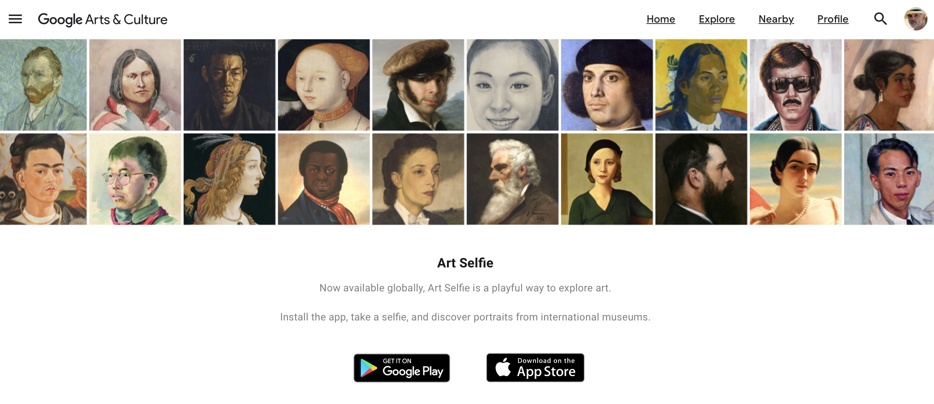
https://artsandculture.google.com/camera/selfie

Slide 27
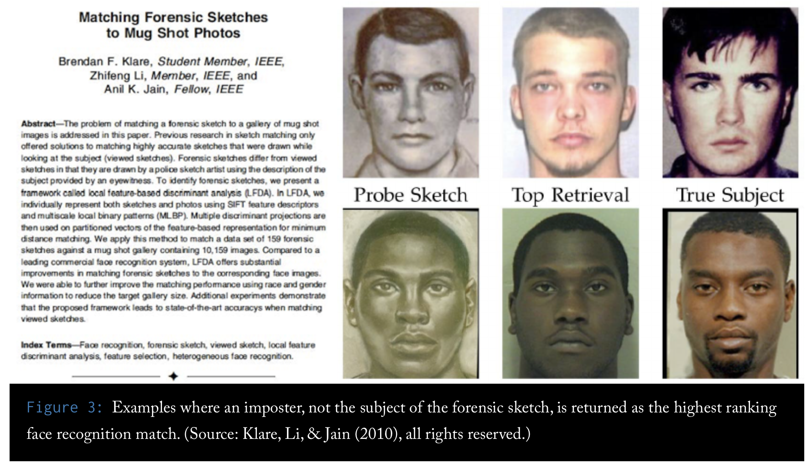
https://www.flawedfacedata.com

Slide 28
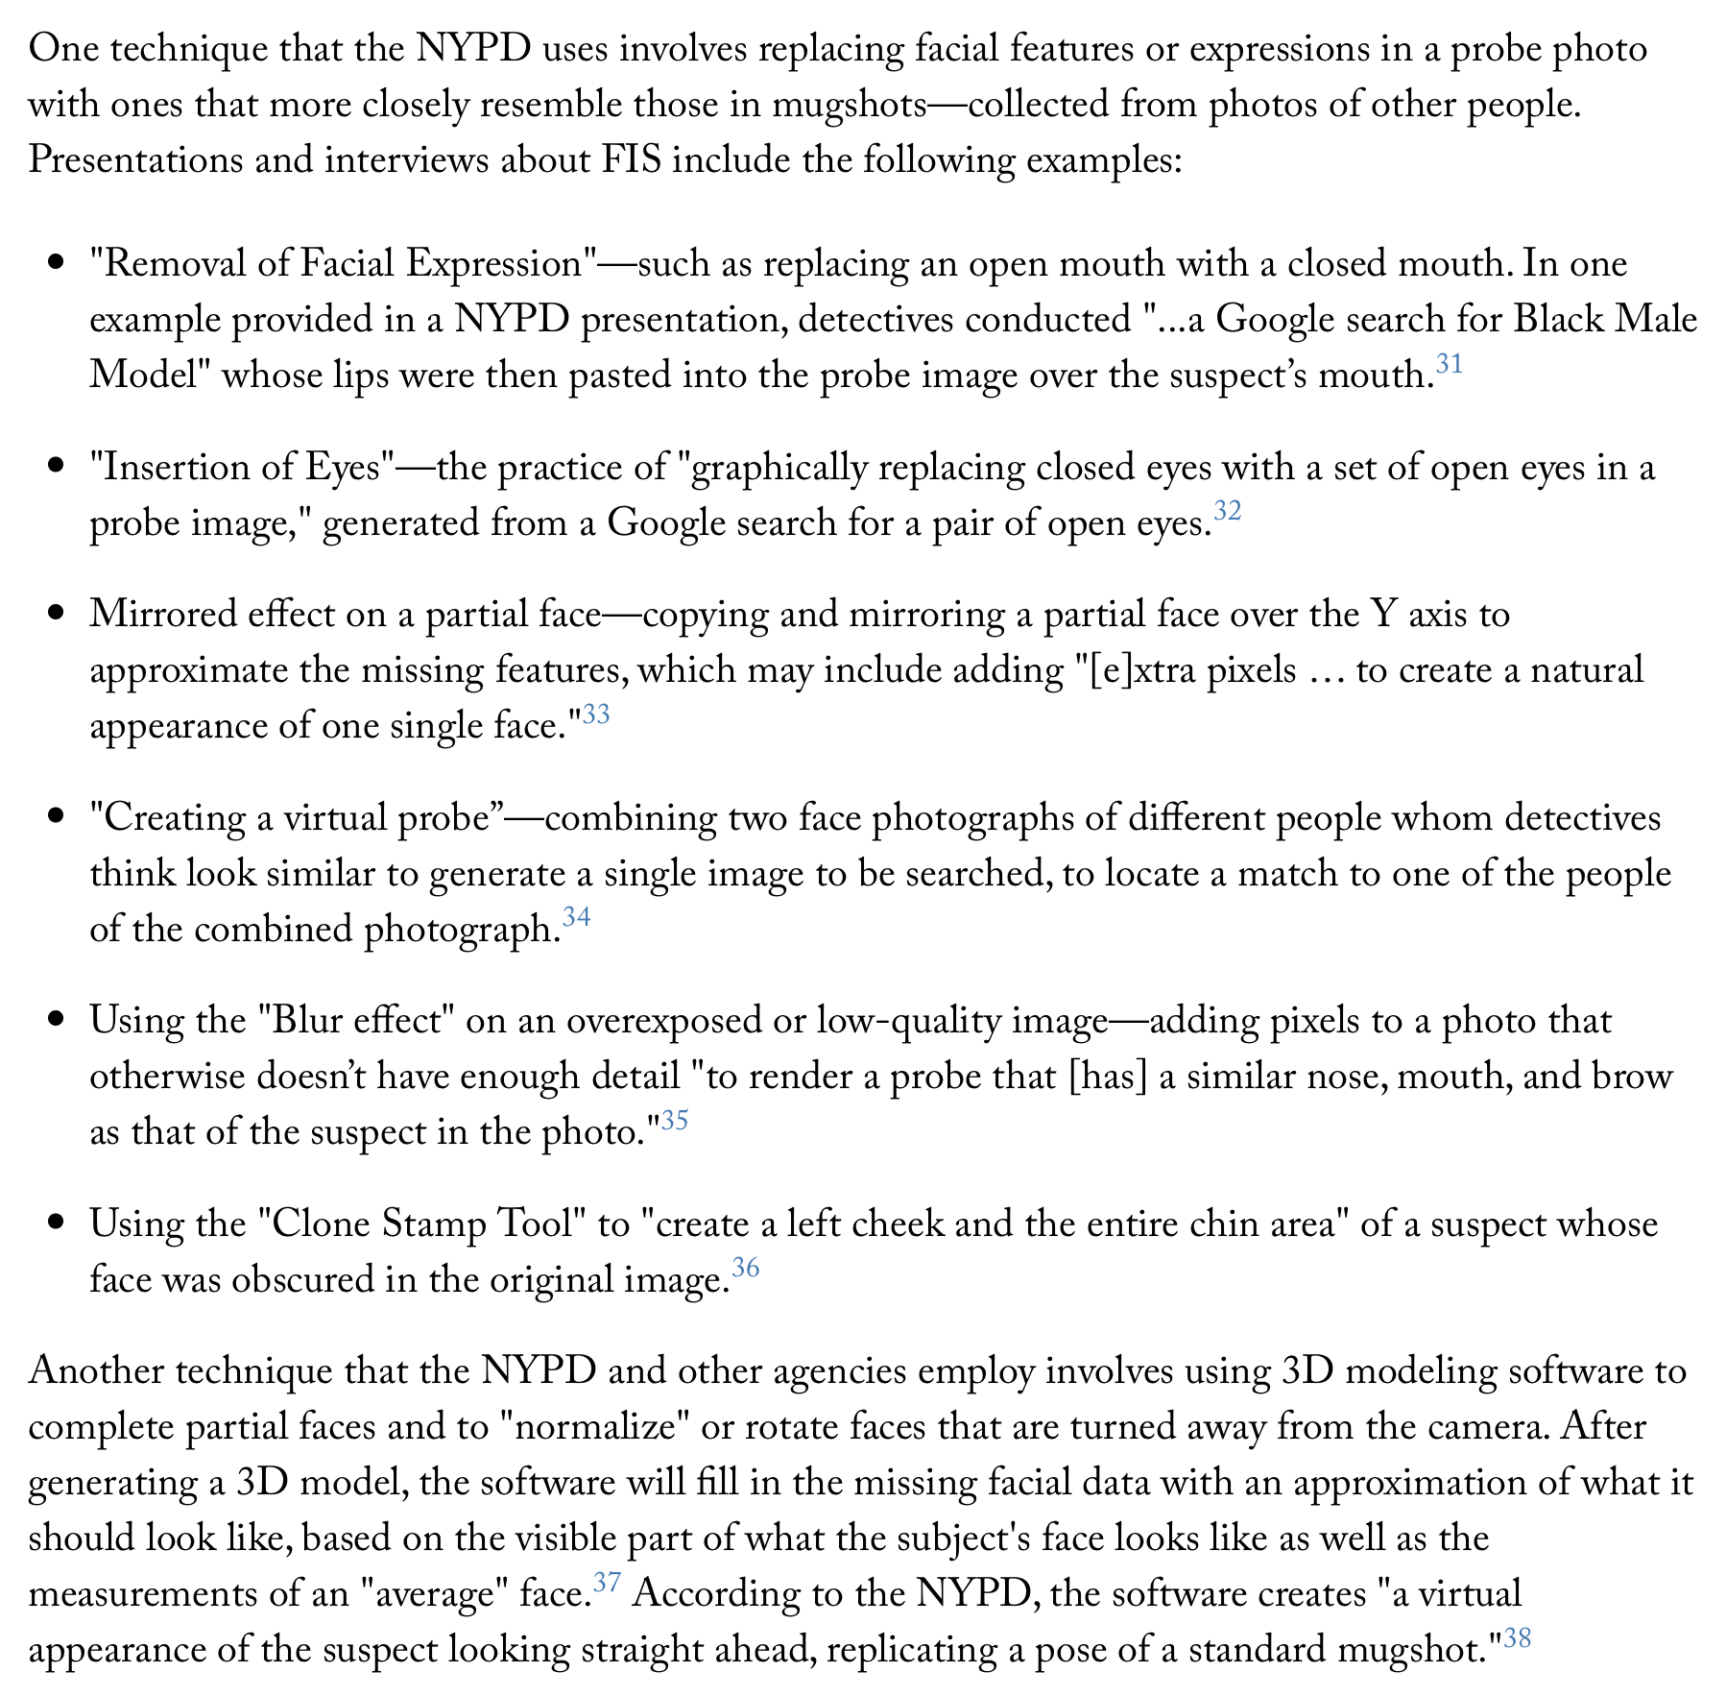

Slide 29
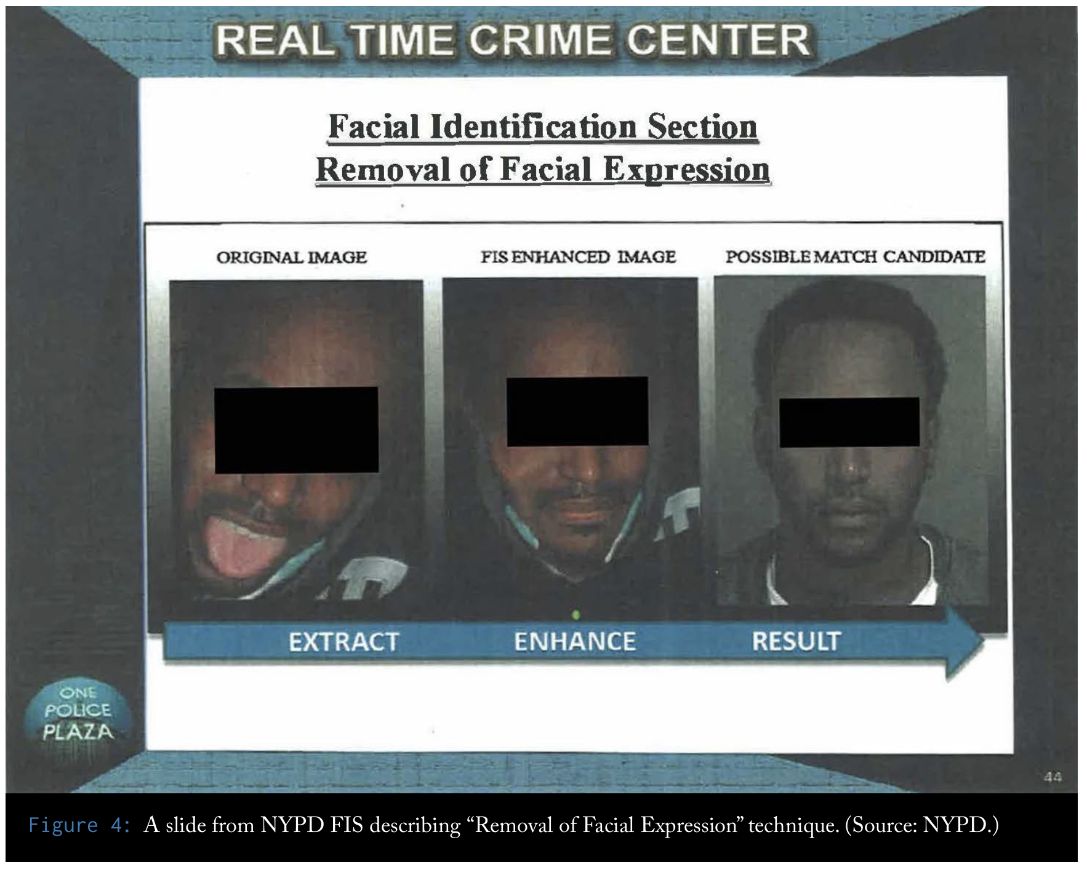
https://www.flawedfacedata.com

Slide 30
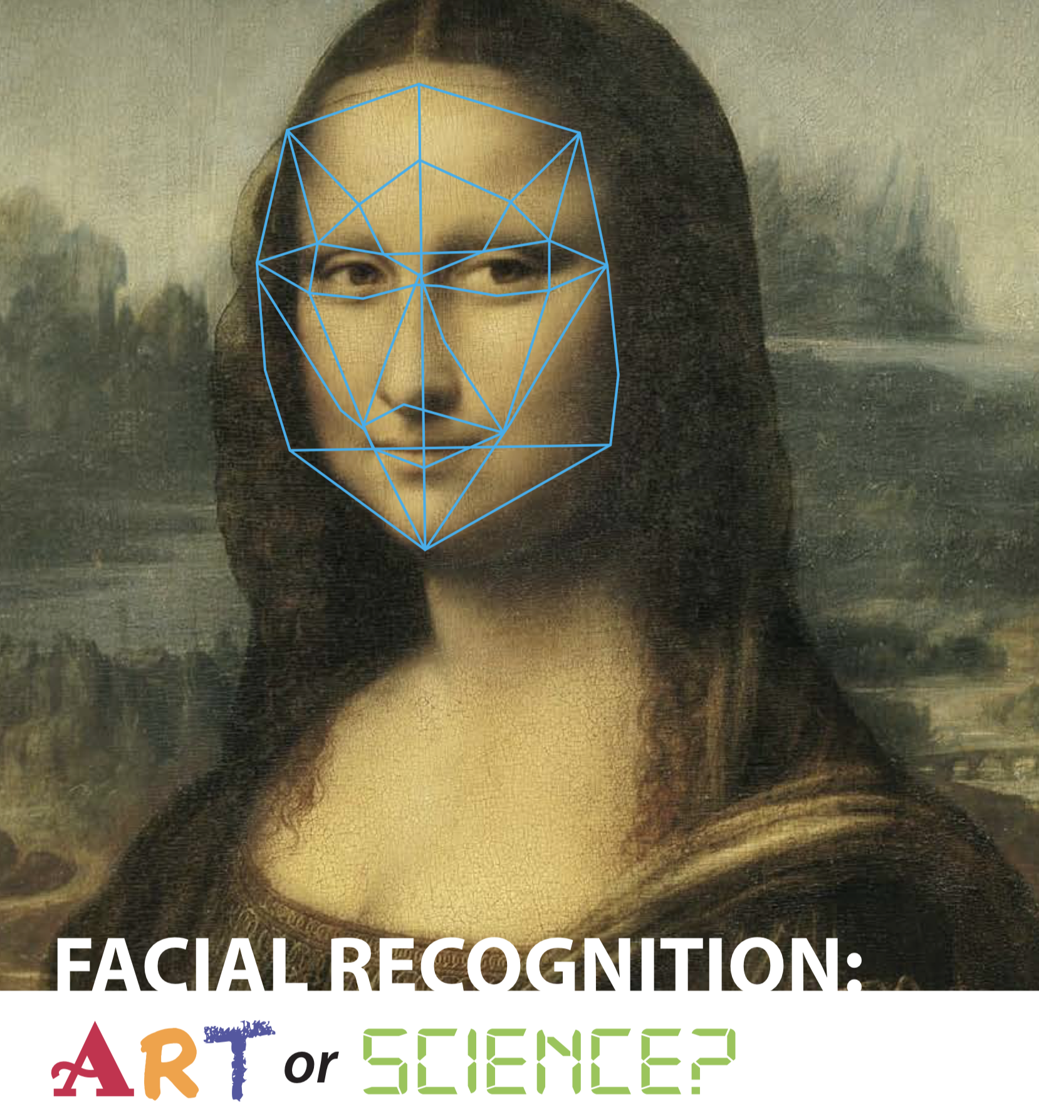
https://bit.ly/35GS91c

Slide 31
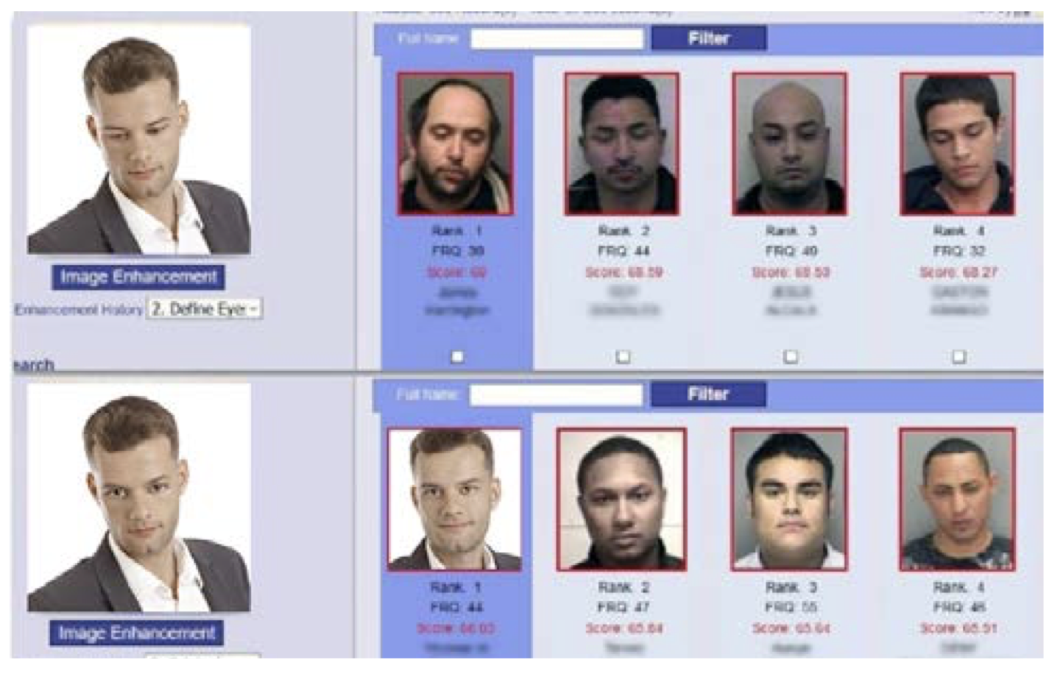
https://bit.ly/35GS91c

Slide 32
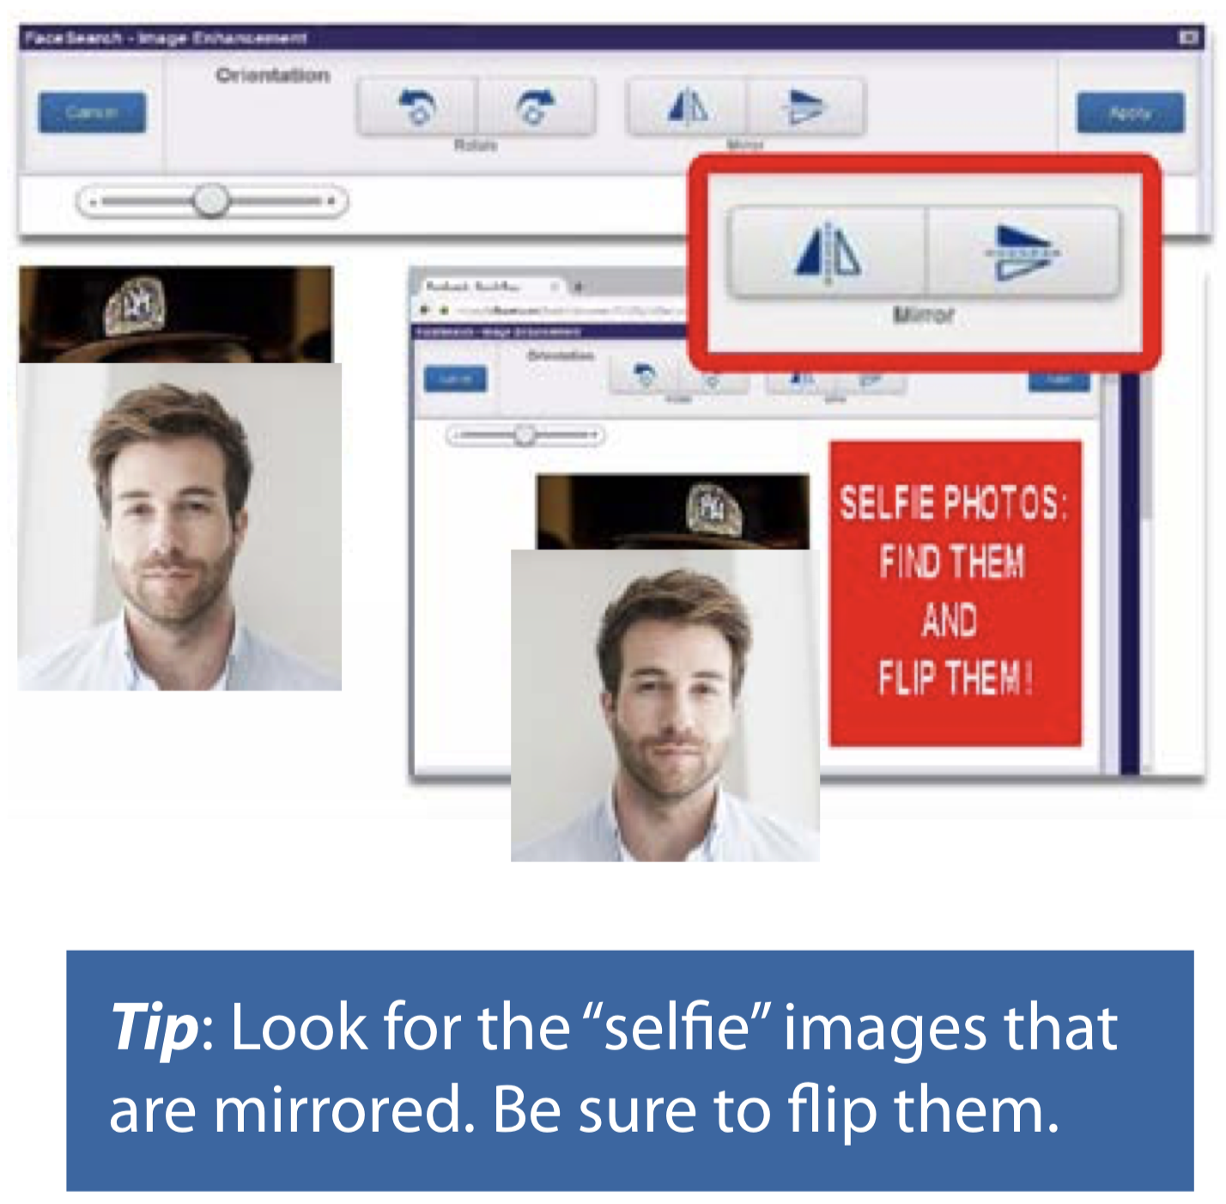
https://bit.ly/35GS91c

Slide 33
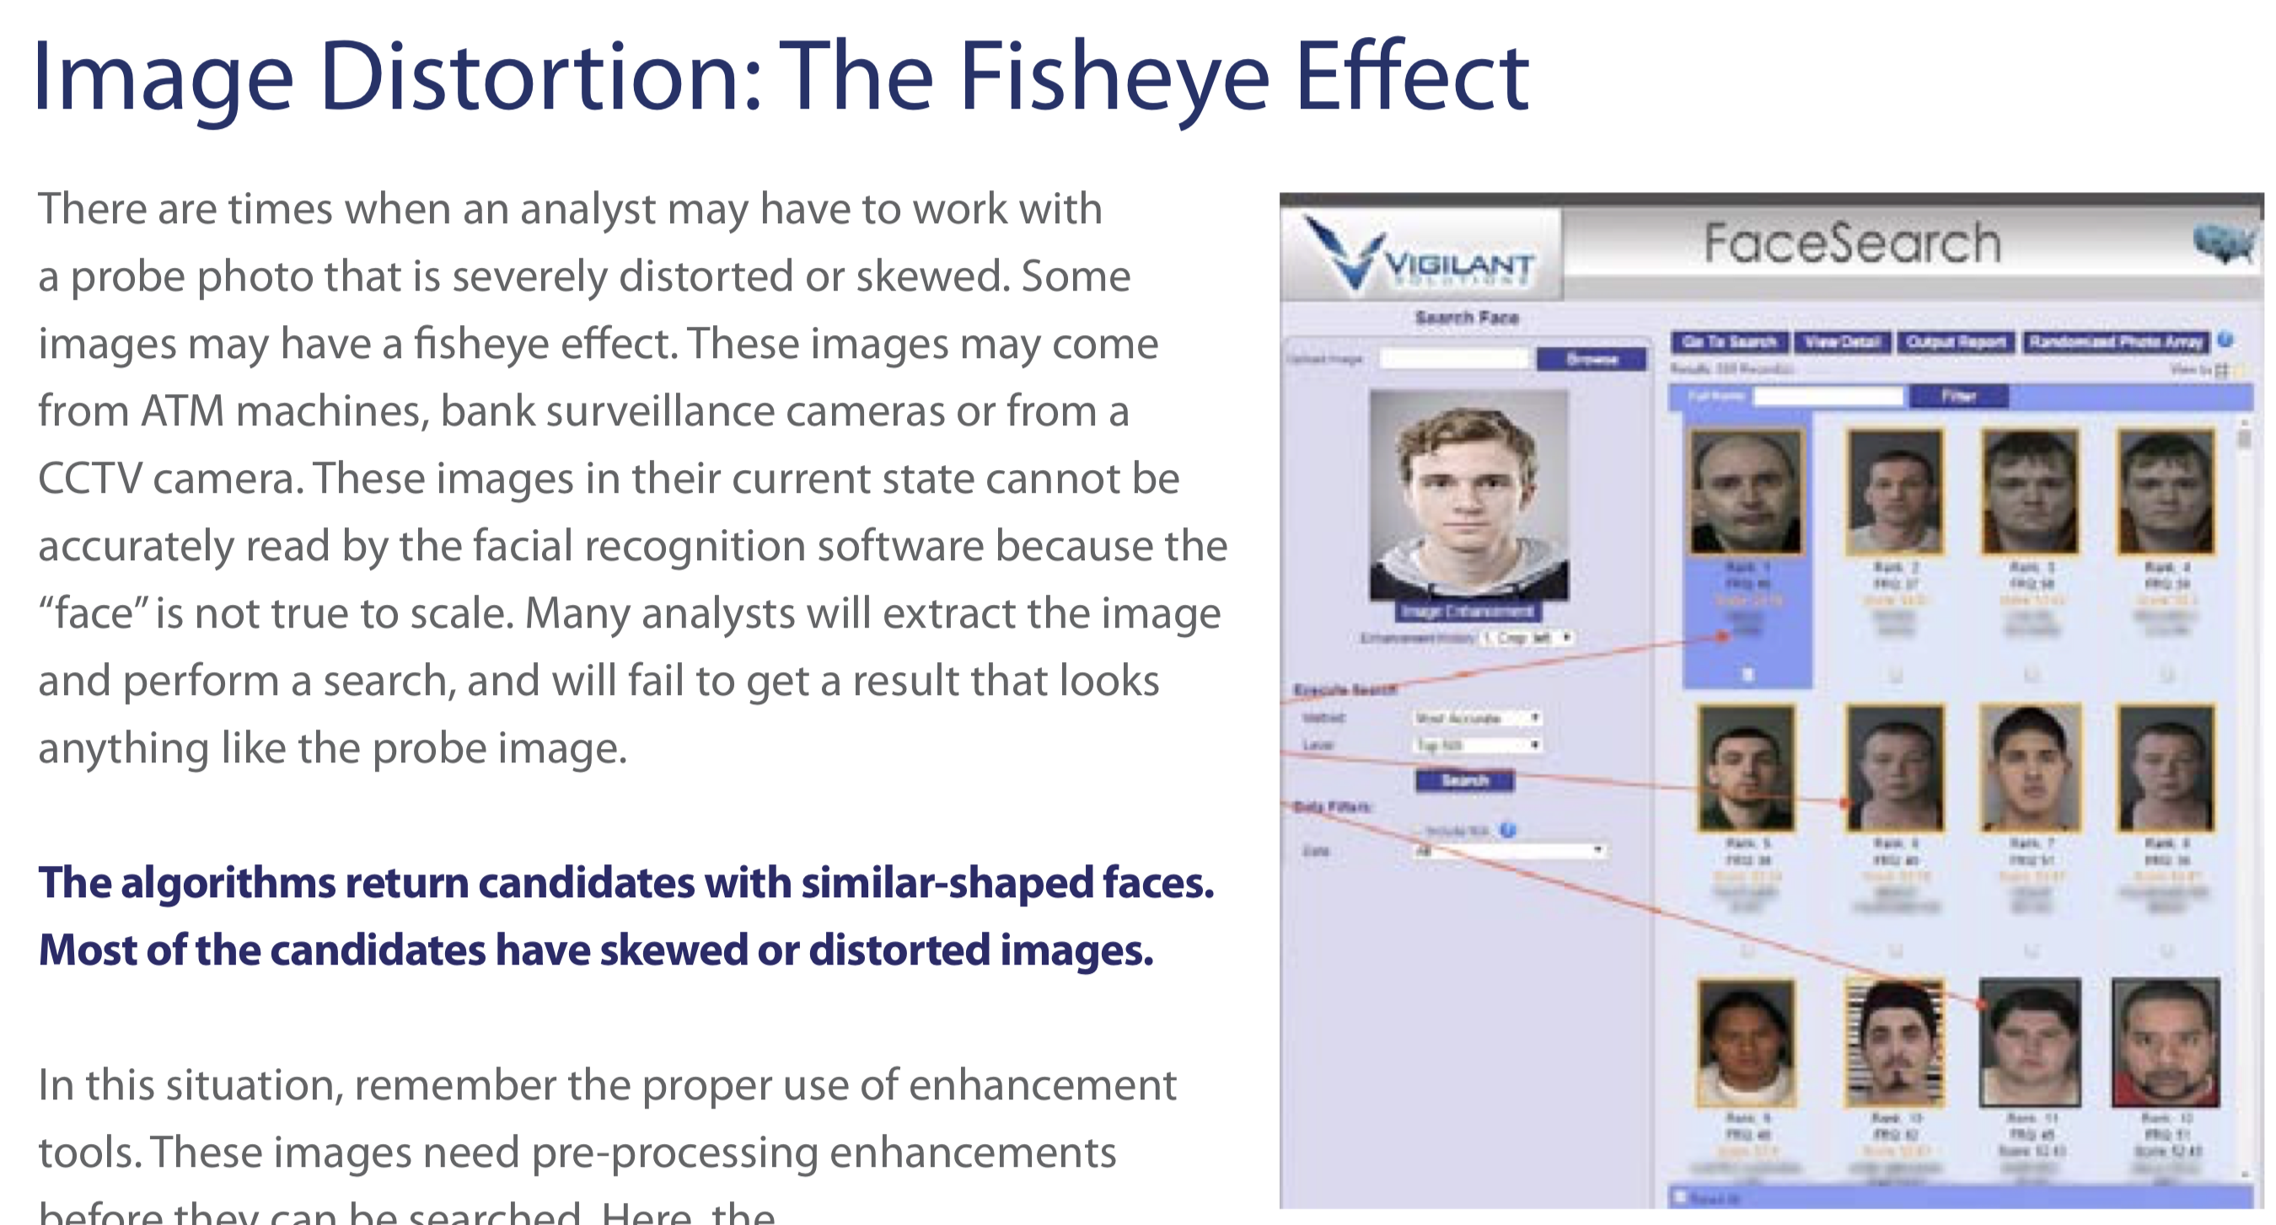
https://bit.ly/35GS91c

Slide 34
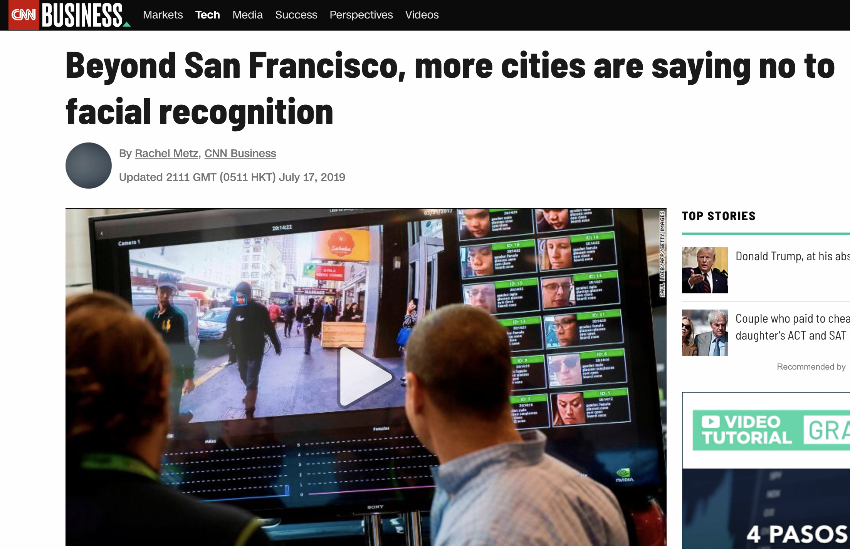
https://cnn.it/2Mnd7e5

Slide 35
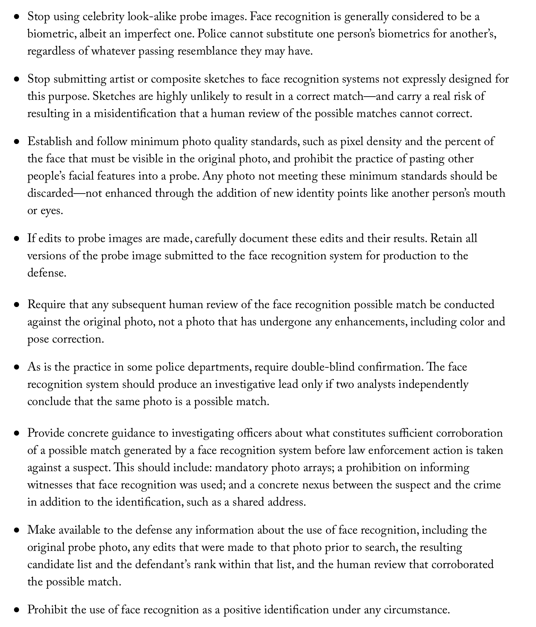
Recommendations from
Center of Privacy and
Technology
https://www.flawedfacedata.com

Slide 36
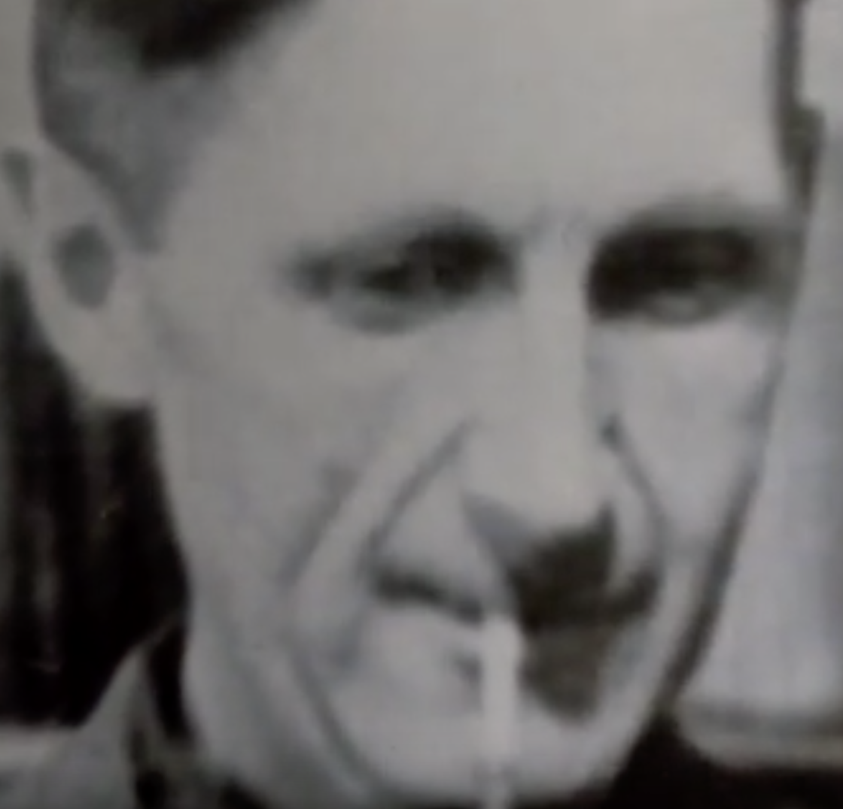
George Orwell - 1984
(written in 1949)

Slide 37



